Slide 1


Lower Key Stage Two
Year 3 & 4
Information Evening

Slide 2
Meet the Team
Year 3
Year 4
Ms Hall
LKS2 Lead, Red Kites
Mr Hamid
Kingfishers
Ms Le Cras
Red Kites LSA
Miss Gomes
Kingfisher LSA
Mrs Ashad
Robins
Mrs Hodder
Owls
Mrs Hart
Robins LSA
Mrs Lokat
Owls LSA

Slide 3
Raise Your Childs Attendance,
-Raise their Chances!
What does “Good attendance” mean?

Slide 4
Do you know what your child's attendance is?
Do you know what it means?

Slide 5
This is Ruju. He is in Year 1 and has 90% attendance.
Is that good?
What does this mean?

Slide 6

Raju’s parents thinks this is pretty good.
Are they right?
90% attendance = ½ day missed every week!!
Mon | Tue | Wed |  | Thur | Fri
 |  | ?
Absent half a day every week

Slide 7
Lets looks a little closer…..
1 school year at 90% attendance = 4 whole weeks of lessons MISSED!!!
38 school weeks
Sept July
 | ?
Absent for 4 weeks

Slide 8
90% attendance over 5 years of primary school….
= ½ a school year missed!
Sept July
½ a year absent from school

Slide 9

What impact might this have on Raju’s life……?
Research suggests that 17 missed school days a year = GCSE grade DROP in achievement. (DfES)
The greater the attendance the greater the achievement.

Slide 10
Percentage Attendance Weekly
90% = ½ day
80% = 1 day
70% = 1 ½ days
60% = 2 days
50% = 2 ½ days
40% = 3 days
30% = 3 ½ days

Slide 11
So 90% is not as good as it first seemed.
What can do as a parent to increase my child's attendance?
I

Slide 12
Ways for parents to encourage attendance:
Find out regularly your child's absence.
Talk regularly with your child about school and how they feel about it. More likely to attend if they feel supported and anxieties listened to.

Slide 13
Ways for parents to encourage attendance:
Phone us as soon as possible to tell us why your child is absent, and when you expect them to return.
Only grant days at home for genuine illness. (you will know!!)
Avoid taking holidays in school time.

Slide 14
Ways for parents to encourage attendance:
Avoid booking doctor’s and dentist appointments during the school day.
Know routines of the school day to avoid issues, e.g. have they got their PE kit?
If you have concerns See Me– I will check attendance and be discreet.
PRAISE AND REWARD GOOD ATTENDANCE

Slide 15

Attend and Achieve!
If a school can improve attendance by 1%, they will see a 5-6% improvement in attainment. (Department for Education and Skills)
Please help us and your child by ensuring their attendance remains above 95%, allowing them to achieve their potential.

Slide 16
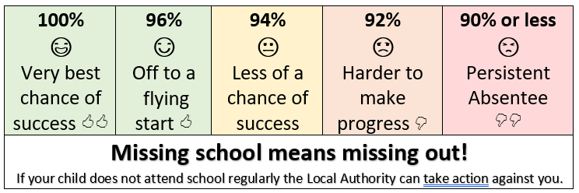
Being in school every day that it is open, is important to your child’s achievement, wellbeing, and their wider development.

Slide 17

Every Lesson Counts….
https://educationhub.blog.gov.uk/2022/09/02/back-to-school-week-everything-you-need-to-know-about-school-attendance/

Slide 18
Percentage Attendance Termly/Yearly
90% = 1 week 2 days = 4 weeks
80% = 2 weeks 4 days = 8 weeks
70% = 4 weeks 1 day = 12 weeks
60% = 5 weeks 3 days = 16 weeks
50% = 7 weeks = 20 weeks
40% = 8 weeks 2 days = 24 weeks
30% = 9 weeks 1 day = 28 weeks

Slide 19




How can I find out what my child is learning in school so I can support them?
On the E P Collier website each year group will upload information about each subject area for each term.
Where on the website can I find this information?!
Class Pages
Top right corner of page

Slide 20



Reading

Slide 21


The importance of being able to read can not be stressed enough!
At E P Collier;
Reading is taught as a class based subject everyday.
Quality texts are used to enhance the children’s fluency
and love of reading
Children who, for what ever reason, are given extra reading and phonics lessons.
This term Year 3 Year 4 are reading The Lion, the
are reading Witch and the Wardrobe

Slide 22


Writing
Writing is also taught as a subject using quality texts as the stimulus.
As the children progress through the years they should be developing legible and well formed letters which eventually will be joined.
There are several good sites that can be accessed from home to support you child
https://teachhandwriting.co.uk/
https://www.letterjoin.co.uk/

Slide 23

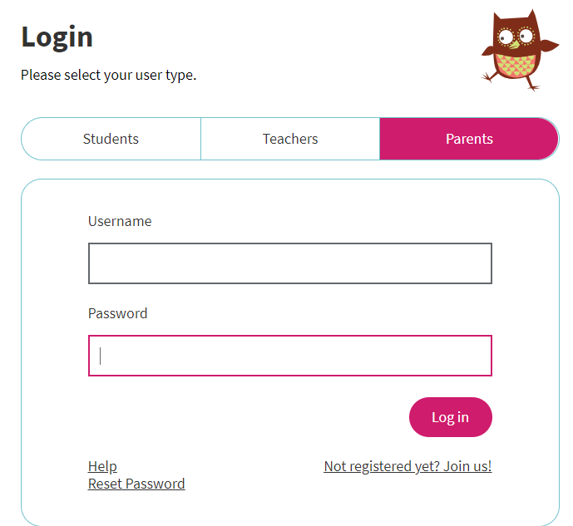

We have also as a school, invested in the Nelson handwriting scheme which children access several times a week.
You can access information on this through the Oxford Owl your child should have received.
Click here

Slide 24

Maths
Throughout the school the children are taught Maths using
This term year 3 and year 4 are revisiting Place Value moving onto Addition and Subtraction
The breakdown of what is being taught will be in the class pages on the E P Collier website.
At the beginning of each topic the children are assessed to see what they already know and then assessed at the end of the topic to ensure progression or to see who may need further support. These are supportive assessments NOT tests!

Slide 25
All other subjects
Along with the key subjects of Maths and English (reading & Writing your child will also be taught throughout the year
Science
Geography
History
RE
PSHE
PE
French
Art
DT
Computing

Slide 26


House Keeping
Expectations in year 3 and 4.
EP Collier is a ‘Healthy Eating’ School.
For breaktime snack children should only be bring in fruit, oat bars (no nuts), or yogurt eg Frubes.
In the children’s water bottles there should be water! Please do not put in juice.
Please, please, please label your child’s uniform including PE kit

