Slide 1
Handwriting and letter formation workshop
July 2016

Slide 2
Because handwriting is such a complex skill, there are many children who have difficulty mastering it. This may cause frustration and distress and affect a child's desire to write. It may also cause anxiety for the parents and teachers who watch the child struggle to put his or her ideas on paper. Not all difficulties are the same or caused by the same factors, and any assessment of the problem must take into account the age and experience of the child.

Slide 3
Benefits of good handwriting:
Confidence in putting your ideas on a page and showing your skill
Fluidity in completing tasks quickly and keeping up with class work
Some research suggests that better handwriting can help with learning as the focus is on the right thing
For younger children it activates the brain more than keyboards
Cursive writing can help children and adults with dyslexia- writing in print means many letters look similar and are hard to distinguish.
By year 6, children are assessed on handwriting and those who don’t use correct cursive script are not deemed ‘secondary ready’.

Slide 4
At EP Collier:
application
single letters
capitals
letter families
joins
See booklet

Slide 5
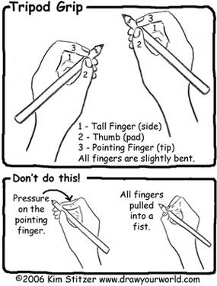
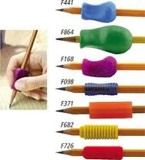

Slide 6
Helping:
Don’t use writing as a punishment!
Try warm- up activities to prepare the hands for action! http://www.teachhandwriting.co.uk/handwriting-warm-up-exercises.html
Use different mediums- shaving foam, sand, water, paint, the air
Allow children to choose different writing implements
Make it a competition!
Model –whiteboards are good to show and repeat and children can rub off if a mistake is made so it is less permanent
Strengthen the muscles in activities that aren’t just handwriting

Slide 7

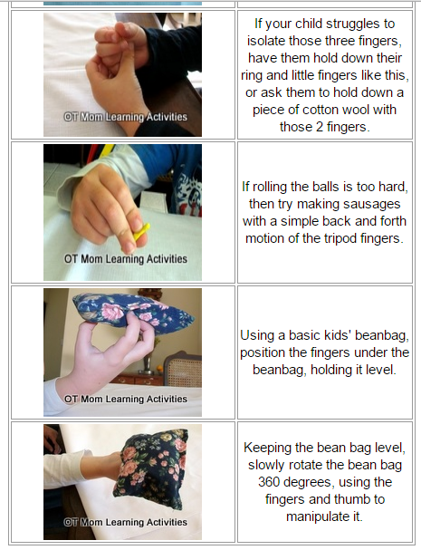

Slide 8
Top tips:
Pick your battles
Have frequent breaks
Motivate them using interests
Do a ‘before’ and after’ piece so your child can see the progress
Lower your standards-positive reinforcement goes a long way!
Model good handwriting yourself
Watch where they go wrong- there is no point telling, find their weakness
demo

Slide 9
Is being left-handed the cause of the problem?
Being left-handed is not of itself a disability. The majority of left-handers write as well as their right-handed peers. Some evidence suggests that they develop fluency a little later than right-handers because they are 'pushing' the pen across the page rather than 'pulling' it, but this should not be a problem in the long-term.
Is it a boy thing?
Research does show that girls pick up more fluent handwriting quicker than boys, though this isn’t a cause for concern- boys will get there in time.

