Slide 1

How to promote a love of reading
Bryony Freedman

Slide 2
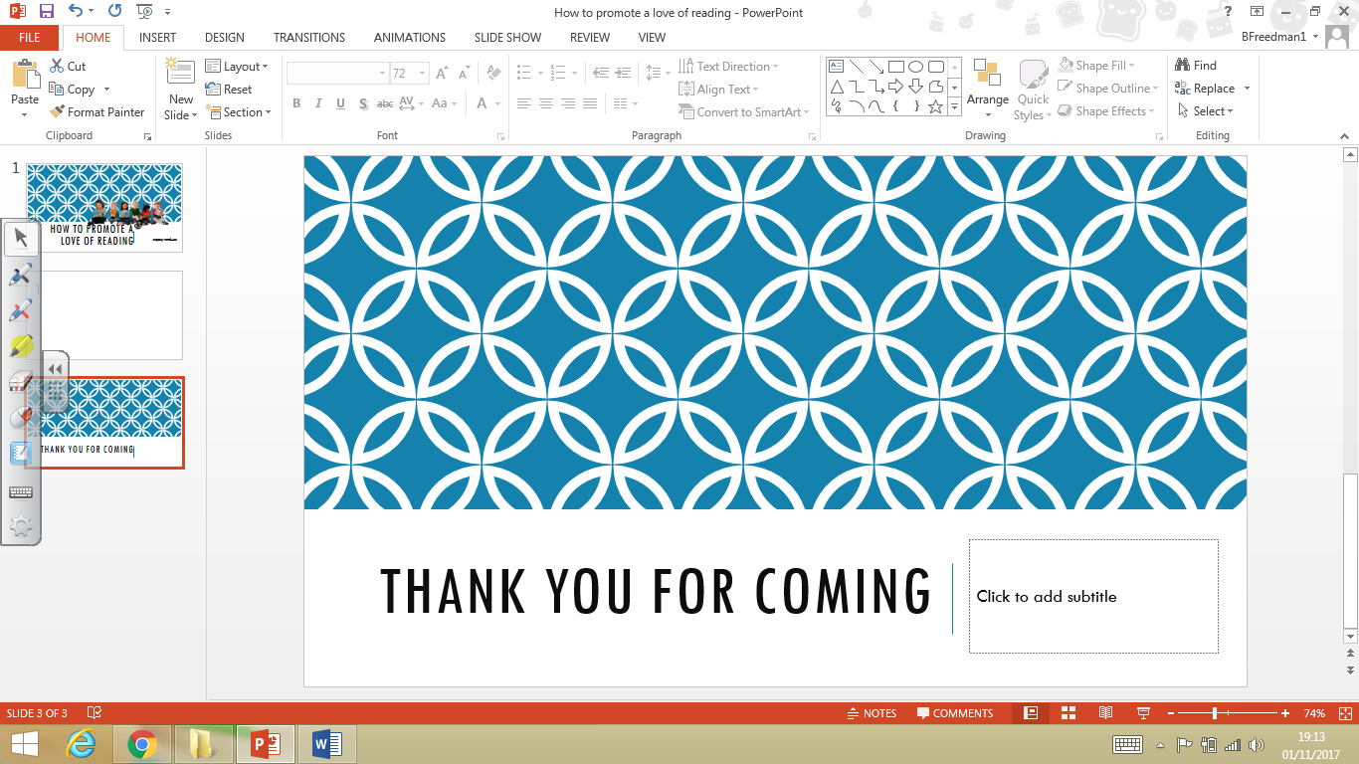
The benefits of developing a love of reading:
"Pupils who can read are overwhelmingly more likely to succeed at school, achieve good qualifications, and subsequently enjoy a fulfilling and rewarding career. In addition to its substantial practical benefits, reading is one of life’s profound joys."
DfE 2015

Slide 3
THE EVIDENCE ON READING FOR PLEASURE:
There is a growing body of evidence which illustrates the importance of reading for pleasure for both educational purposes as well as personal development (cited in Clark and Rumbold, 2006).
Evidence suggests that there is a positive relationship between reading frequency, reading enjoyment and attainment (Clark 2011; Clark and Douglas 2011).
Reading enjoyment has been reported as more important for children’s educational success than their family’s socio-economic status (OECD, 2002).
There is a positive link between positive attitudes towards reading and scoring well on reading assessments (Twist et al, 2007).
Regularly reading stories or novels outside of school is associated with higher scores in reading assessments (PIRLS, 2006; PISA, 2009).
International evidence supports these findings; US research reports that independent reading is the best predictor of reading achievement (Anderson, Wilson and Fielding, 1988).
Evidence suggests that reading for pleasure is an activity that has emotional and social consequences (Clark and Rumbold, 2006).
Other benefits to reading for pleasure include: text comprehension and grammar, positive reading attitudes, pleasure in reading in later life, increased general knowledge (Clark and Rumbold, 2006).

Slide 4
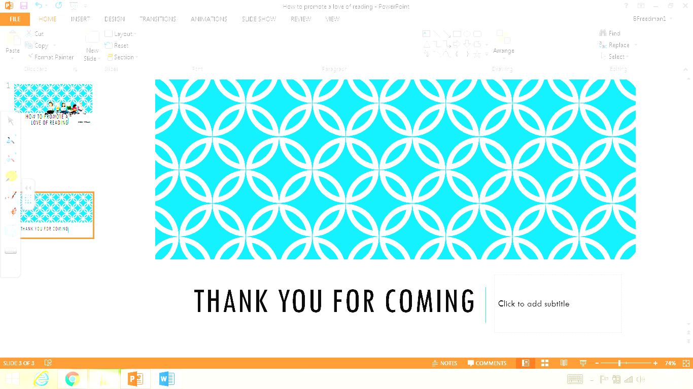
How to support your child to become a lifelong reader:
Shared reading
1. It’s still good to share
Don’t give up on talking about picture books with your child and sharing that bedtime story or information book. It’s just as important now to enjoy reading these books together, as well as those that come home from school, to help develop your child’s vocabulary, their understanding of stories and to encourage a love of reading.
2. Read with expression
Read with expression when reading to your child. Use different voices and vary the volume for effect or for different bits of information such as, Did you know that the Tyrannosaurus Rex...? Wow! You’ll soon see that your child will then try these skills when reading to you!
3. Talk about books, words and pictures
Before reading a book together, always talk about the title, the pictures and the information on the cover (front and back). If it’s new, ask what your child thinks the book might be about. If it’s an old favourite then talk about the bits you love most! Don’t worry if some books get chosen again and again!
4. Retell stories or events
When reading aloud use lots of expression and try different voices for different characters. Get your child to join in with bits too, such as, ‘They pulled and they pulled!’ and ‘Fee, fi, fo, fom...’. See if your child can copy you!

Slide 5
How to support your child to become a lifelong reader:
Practising early reading skills
1. Listen to your child read
Books that your child brings home from school should be at the right level for your child. The words should be readable for your child – we say they are levelled reading scheme books. They are written to ensure steady progress and success. Many of these books include helpful notes for parents inside the front cover.
2. Sound it out
If your child gets stuck on a word, try phonics first. Get your child to say the letter sounds and say them quickly to try to hear the word; this is called blending . If the word can’t be sounded out then it’s best if you say it quickly and move on. If the book is at the right level then this should not happen too much.
3. Clap and chunk
Clapping out syllables or chunks in words and names can help with reading longer words: Di-no-saur! Cho-co-late! Or point out that some words are made up of two words, so wind and then millmakes windmill .
4. Don’t be afraid to back track
It’s sometimes good to get your child to re-read a sentence or even a page if it has been tricky to work out. This helps with meaning, flow and confidence – we all still have to do this sometimes!
5. Read, read, read!
It’s really important to read as much as possible with your child. Read the books that come home from school, borrow library books, buy books and magazines. Read signs and notices, and find interesting websites to read. And keep reading together at bedtime too!

Slide 6
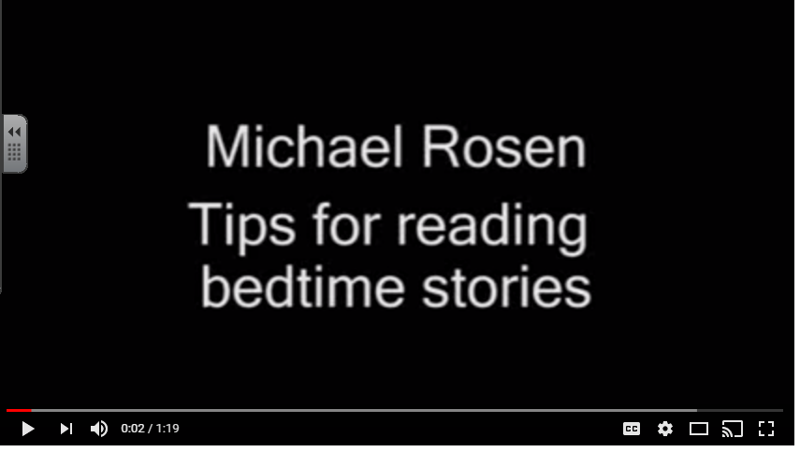
How to support your child to become a lifelong reader:
https://www.youtube.com/watch?v=azRDNDQUjSk&app=desktop

Slide 7
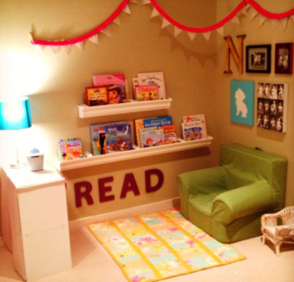
How to support your child to become a lifelong reader:
Make your own reading corner-
A safe cosy space to escape into a book.

Slide 8
Useful weblinks
https://www.oxfordowl.co.uk/for-home/advice-for-parents/reading-at-home/helping-struggling-readers/what-to-do-if-you-think-your-child-is-a-struggling-reader/
https://www.oxfordowl.co.uk/for-home/reading-owl/find-a-book/library-page?view=image&query=&type=book&age_group=Age+5-6&book=1&book_type=&series=#
https://clubs-kids.scholastic.co.uk/filter/age/47?page=3
https://teachers.theguardian.com/system/files/assets/698/10607/ReadingForPleasureleaflet.pdf
http://www.scottishbooktrust.com/watch-on-demand
http://www.scottishbooktrust.com/reading/book-lists/kids
http://www.scottishbooktrust.com/learning/teachers/scottish-childrens-book-awards

Slide 9
Thank you for coming

