Slide 1

Phonics
Parents’ Workshop
E P Collier
Primary and Nursery School
Justin Lee - Thursday 3rd March – 2:00 – 3:00

Slide 2
What is Phonics?
Phonics is the breaking down of words into their smallest possible sounds:
c-a-t d-o-g ph-o-n-i-c-s
It is a strategy that can be used for both reading and spelling. Much research has been done into phonics. Several studies have shown that it provides most children with the best possible chance at reading or decoding words.

Slide 3
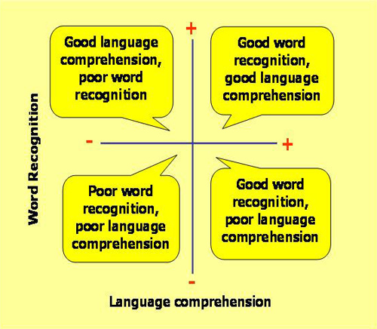
Simple View of Reading
Reading can be broken down into two processes: word recognition; and language comprehension. Phonics helps with word recognition or decoding of the words. Phonics does not help with the language comprehension; the understanding of what is being read. This is done through questioning and discussion before, during and after reading a book or text.

Slide 4
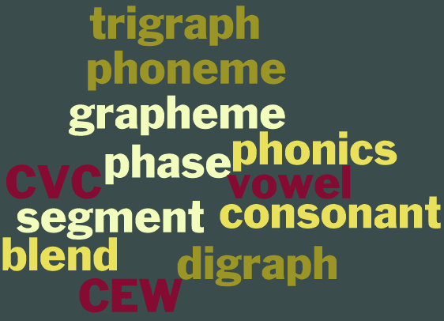
Technical vocabulary
Phonics is full of technical vocabulary. It is important to use the correct vocabulary because it explains what is happening with the words or the language. Don’t worry children love new vocabulary, and will start to use it very quickly.

Slide 5
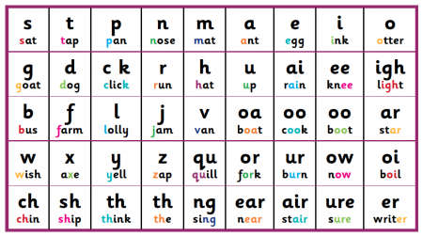
Phoneme
Phonemes are the smallest possible unit of sound. This can be made by one or several letters. In the English language there are ~44 phonemes.

Slide 6
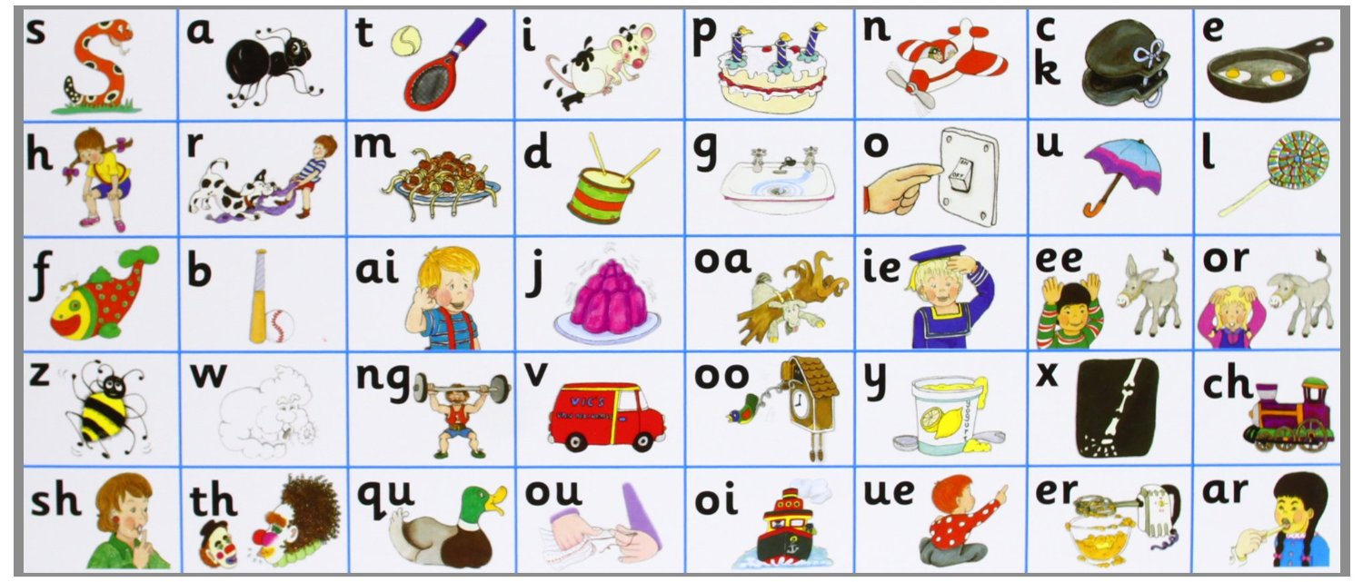
Grapheme
Graphemes are the letter/s used to write the phoneme, or the written representation of the phoneme or sound. There are ~120 graphemes in the English language.

Slide 7
Vowel and Consonant
The alphabet is made up of 26 letters and these can be split into vowels and consonants.
Vowels:
a e i o u
Consonants:
b c d f g h j k l m n p q r s t v w x y z

Slide 8
Digraphs & Trigraphs
Digraph – two letters making one grapheme.
Au – g – u – s – t l – o – ng p – ai –n
Trigraph – three letters making one grapheme.
s – igh – t c – ure c – l – ear
Graphemes with four or more letters are called multi-letter graphemes.
d – ough c – augh - t eigh - t

Slide 9
Grapheme – Phoneme Correspondence (GPC)
GPC (grapheme – phoneme correspondence) means being able to match the grapheme to a phoneme and vice versa.

Slide 10
Blending for Reading
When reading a word the children segment the word (break it down) into the smallest possible phonemes and then blend these together.
cat
c – a – t
stegosaurus
s – t – e – g – o – s – au – r – u – s

Slide 11
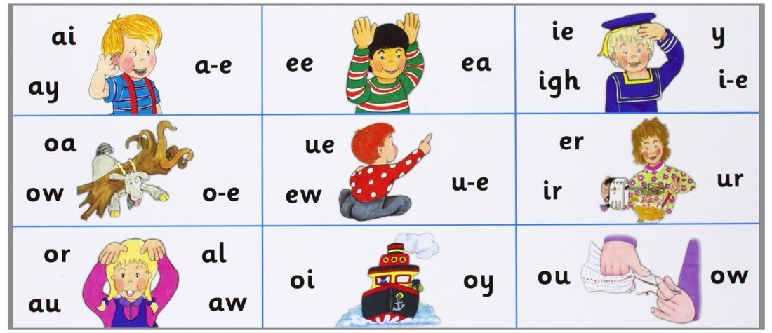
Segmenting for Spelling
When spelling a word the children will segment the word (break it down) into the smallest possible sounds and attempt to write them down grapheme by grapheme. A good strategy is to count the number of phonemes using fingers and then identifying the grapheme using a phonics mat.

Slide 12
Enunciation and Pronunciation
Enunciation, the way our mouths form the phonemes, and the pronunciation, the vocal sound being made, are both very important when teaching phonics. It is important that phonemes are spoken and formed correctly to enable children to blend accuartely. Often people add on an extra ‘er’ sound, such as ‘ler’ for ‘l’. This is called an added schwa (ə) effect. Be mindful of the individual sounds or phonemes when segmenting and how they should sound. There are many websites out there that can help with hearing and practising the correct enunciation and pronunciation. One of these that we highly recommend is ‘Mr Thorne Does Phonics’.

Slide 13
Practise the Phonemes

Slide 14

Quiz Time
How many phonemes are in these words? Tip: use your fingers to help count them.
cat
boy
strap
twenty
bird
knight
eight
make

Slide 15
Common Exception Word
Common exception words cannot be spelt or read using phonics. Here are some examples taken from the National Curriculum (2014) for Years 1 and 2:
the there could some were where was door move half beautiful children full said people friend busy water money Mr Mrs who most kind gold path eye

Slide 16
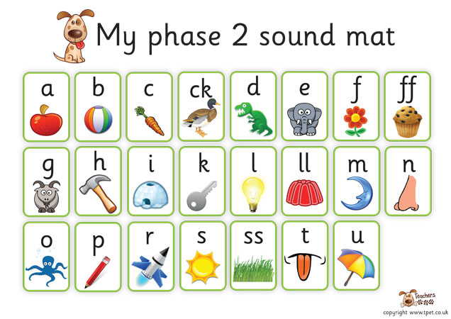
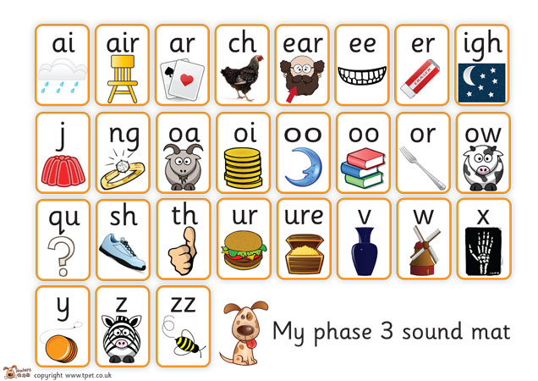
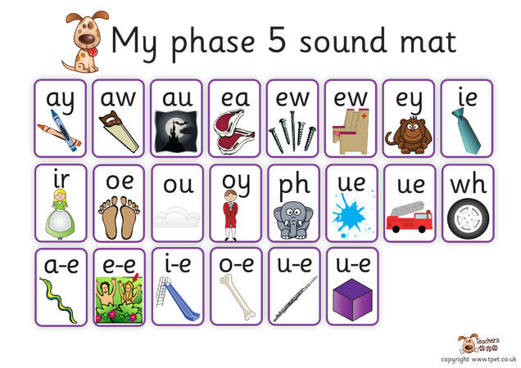
Phases
The National Curriculum (2014) instructs teachers to use phonics as the prime method for decoding (reading and spelling) words. The teachers teach from a programme called Letters and Sounds, complimented by the National Curriculum (2014). This is broken down into six phases or areas of learning.

Slide 17
Phase One
Environmental sounds
Instrumental sounds
Body percussion (e.g. clapping and stamping)
Rhythm and rhyme
Alliteration
Voice sounds
Oral blending and segmenting (e.g. hearing that d-o-g makes ‘dog’)
We also introduce Jolly Phonics to the children, which assigns an action to the phoneme.

Slide 18
Phase Two
Children begin to learn that letters make phonemes or sounds. They are taught the 19 most common phonemes. They learn how to blend and read CVC (consonant-vowel-consonant) and VC words. They also learn some common exception words.

Slide 19
Phase Three
Children are introduced to the remaining phonemes. This includes a wider range of digraphs and trigraphs. The children are also taught more common exception words.

Slide 20
Phase Four
During this phase children are not taught any new phonemes. From now on the teaching and learning of phonics is focused consolidating the skills necessary for decoding and spelling new words. The children begin to use phonics to decode and spell much longer words. They are taught words which have adjacent consonants, including CCVC and CVCC words. The adjacent consonants can sometimes be tricky to hear or sound out, for example: milk; belt; fact. They also learn some additional common exception words.

Slide 21
Phase Five
A lot of time is spent learning Phase 5, therefore we split it into three sections 5a, 5b and 5c. We teach children that some graphemes can have alternative pronunciations, for example: a hard ‘c’ for cat; or a soft ‘c’ in place. The children are also shown that some phonemes can have multiple graphemes, for example: ai; ay; a_e; eigh; ey; ei. These are called alternative graphemes. They also learn more common exception words.

Slide 22
Phase Five cont. Split digraph
During Phase 5 we also teach the children the rule for split digraphs. This used to be referred to as the magic ‘e’, however we do not use this term with the children anymore. The split digraph is when the ‘e’ at the end of the word changes the vowel sound within the word. Here are some examples of split digraphs:
make take lake theme scene complete time lime slime bloke
bone stone flute cube cute

Slide 23
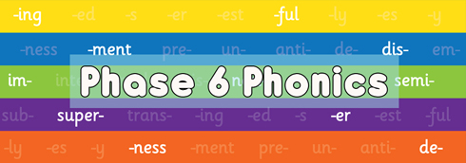
Phase Six
Phase six is where children begin to build up fluency, accuracy and mastery of phonics skills taught so far. It also teaches spellings patterns, including suffixes and prefixes. The children learn less common spellings of words and graphemes. Technically once someone enter Phase six they never leave.

Slide 24
Year 1 Phonics Screening
At the end of Year 1 (June) the children complete a Phonics Screening Check. This is a short assessment of 40 words. Half of these words are real words and half are pseudo (made up) words. The words are chosen to check that they can accurately segment and blend words up to Phase 5c. The inclusion of pseudo words helps with this assessment of phonics and is nothing to worry about. The children are aware that they are not real. The pass mark is usually ~32 words accurately decoded. If you have any questions regarding the phonics check please ask the Year One teachers, or the Phonics or English subject lead teacher in the school.

Slide 25
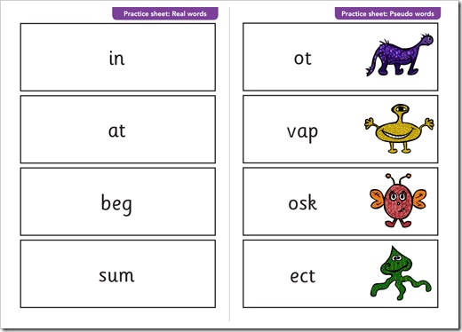
Year 1 Phonics Screening Example

Slide 26
Useful Websites
http://mrthorne.com/
http://www.phonicsplay.co.uk/
http://www.oxfordowl.co.uk/for-home/phonics-made-easy
http://www.letters-and-sounds.com/

