Slide 1
Raising Standards Through Vocabulary Development
“The ways of words, of knowing and loving words, is a way to the essence of things, and to the essence of knowing.” – John Donne (contemporary playwright/poet of Shakespeare)

Slide 2
Aims of the session
To discuss barriers for children at EP Collier
To develop our understanding of what we mean by vocabulary and why it is important to close the vocabulary gap
To explore practical strategies to help close the vocabulary gap

Slide 3
What Difficulties/Barriers to learning may children have regarding vocabulary?

Slide 4
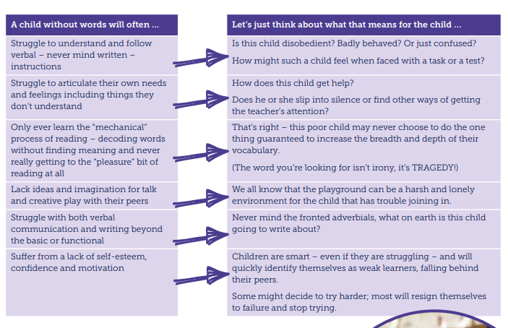
Does any of this sound familiar…?

Slide 5
So… What do we mean by vocabulary?

Slide 6
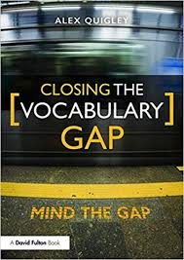
In essence…
All of the things we have just discussed are examples of what is meant by a vocabulary/word gap.
Steven A Stahl states, “Vocabulary knowledge is knowledge; the knowledge of a word not only implies a definition, but also implies how that word fits into the world.”

Slide 7


Slide 8
Who has a vocabulary gap?
Is it present in specific groups or individuals?
  It can be children with English as a second language but not always. It can impact any child in any subject or across a range of subjects.

Slide 9
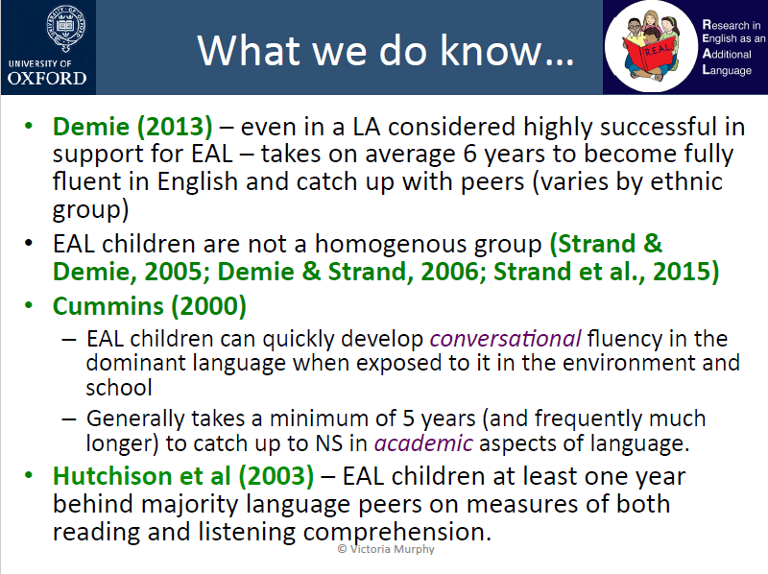

Slide 10
Why is closing the vocabulary gap important?

Slide 11
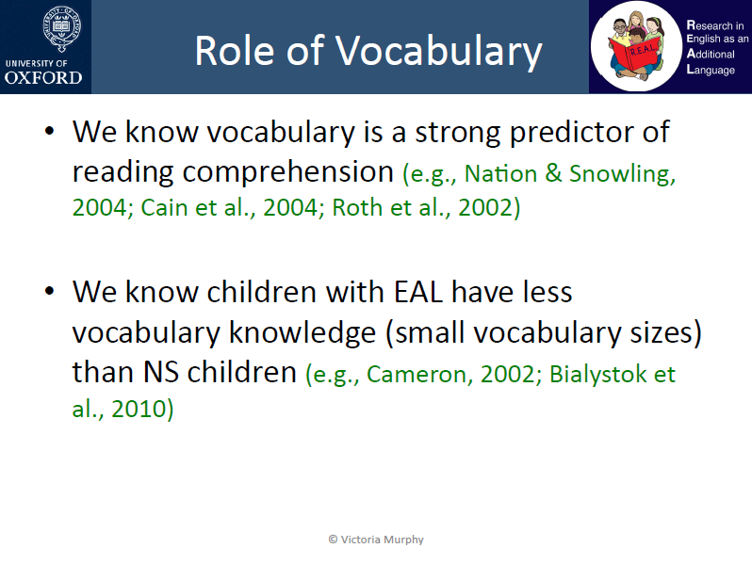
What percentage of words in a text need to be known to ensure comprehension?

Slide 12
Alex Quigley states that:
Being in a word poor context at a young age can have far-reaching negative consequences for our children. Studies show a restricted vocabulary at a young child goes on to correlate with factors in later life such as employment, pay and even health and well-being as an adult.
By explicitly teaching a mere 300 -400 words a year, we can foster an annual growth of around 3,000-4,000 words. From reception to leaving school we can therefore help children develop an essential word hoard of something like 50,000 words.
The challenges of the new academic curriculum in England are related to an increase in reading comprehension demand. Complex academic vocabulary is one of the biggest drivers when it comes to an increased degree of difficulty in the new curriculum.
Supporting children to read more is vital to helping them grow their vocabulary. We should encourage children to read broadly for pleasure, whilst immersing children in word-rich environment that have a focus on vocabulary.

Slide 13
How do we teach these 300-400 words?
Studies have shown that children struggle to retain and appropriately apply the vocabulary taught.
“Most teachers, research tells us, develop children’s vocabulary by explaining a new word once. For some that is enough, but not for all.” - Jean Gross CBE
So how do we help the children to do this?

Slide 14
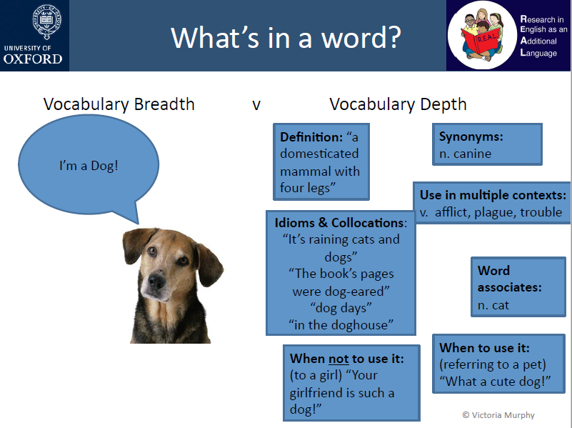
Brunette trees colossal chips/ ocean happy clothes word mats vocab with no definition or pics

Slide 15
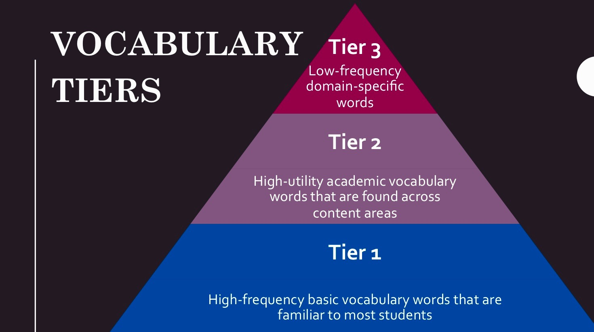
What do we mean by tier 1, 2 and 3 vocabulary?
What tier would these words fit in to?
Propeller
Grass
investigate
Can you think of any other examples of words that would fit into these different tiers?

Slide 16
How can I help my child?
Let’s look at the vocabulary your child will need to know.
On your tables are knowledge organisers for the subjects your children have learnt/will be learning this school year.
If you have not seen them before, they should be on your child’s class webpage.
There is a section dedicated to some of the vocabulary that they will be learning.
There may be other words related to the topic that your child doesn’t know.

Slide 17
What can I do with this vocabulary?
There are many great resources that all have similar ideas around the teaching of vocabulary.
Here are some examples:
https://www.youtube.com/watch?v=d9u3KxGCio8
Guess The Word/Definition
Frayer Model

Slide 18
Thank you for your time and support

