Slide 1
Maths Workshop
3rd May 2018
Miss Gillanders
Maths Subject Leader

Slide 2
Aim of this session
Familiarise yourselves with the concrete materials that we use in school-CPA approach to maths
New Calculation Policy
Theory - New National Curriculum Approach
Mental agility games/examples for you to play with your child at home

Slide 3
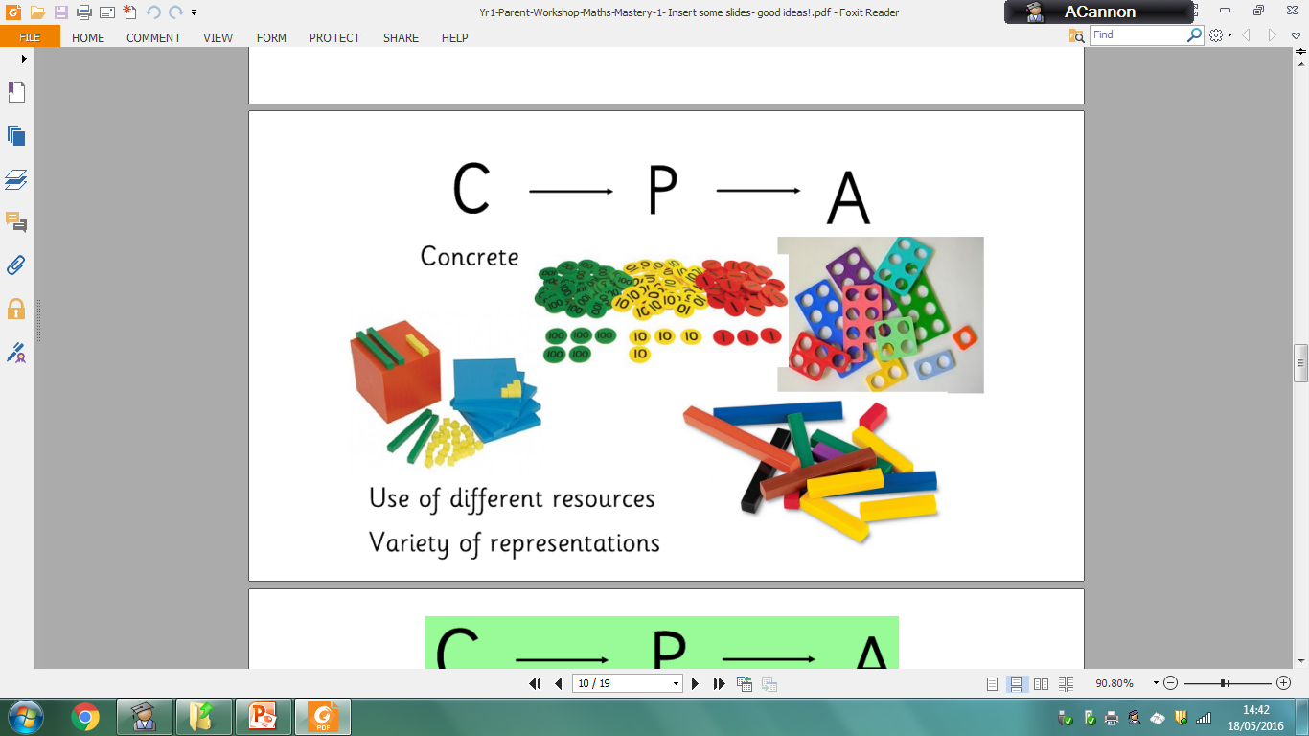
Abstract
Pictorial

Slide 4
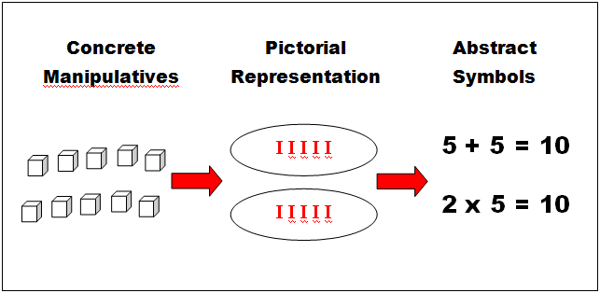
Above is an example of the CPA approach to show the concept of multiplication.

Slide 5
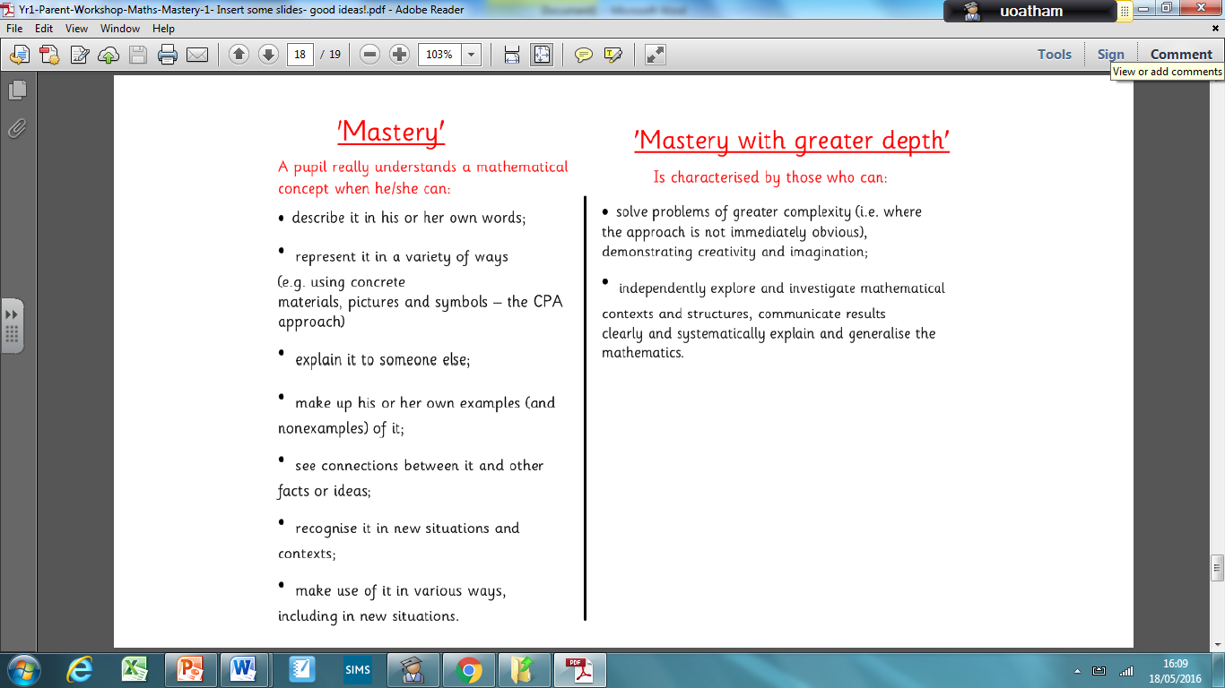
New National Curriculum Approach
Focus of the new curriculum is on DEPTH not BREADTH. The buzz word for this is ‘mastery’.
https://www.activelearnprimary.co.uk/resource/501952

Slide 6
Aims
The national curriculum for mathematics aims to ensure that all pupils:
become fluent in the fundamentals of mathematics, including through varied and frequent practice with increasingly complex problems over time, so that pupils develop conceptual understanding and the ability to recall and apply knowledge rapidly and accurately.

Slide 7
Aims
The national curriculum for mathematics aims to ensure that all pupils:
reason mathematically by following a line of enquiry, conjecturing relationships and generalisations, and developing an argument, justification or proof using mathematical language.

Slide 8
Number Fluency
Number fluency
In the new National Curriculum, there is a greater emphasis on arithmetic, including both written and mental calculations.
By the age of 9, children will be expected to know all times tables up to x12.
Three key goals – efficiency, accuracy and flexibility.
• Efficiency – children have strategies that they understand, that don’t have too many steps, where they can keep track of their working etc.
• Accuracy – children can record carefully, use known facts correctly and check their answers.
• Flexibility – children can choose appropriate skills and strategies to solve problems.

Slide 9
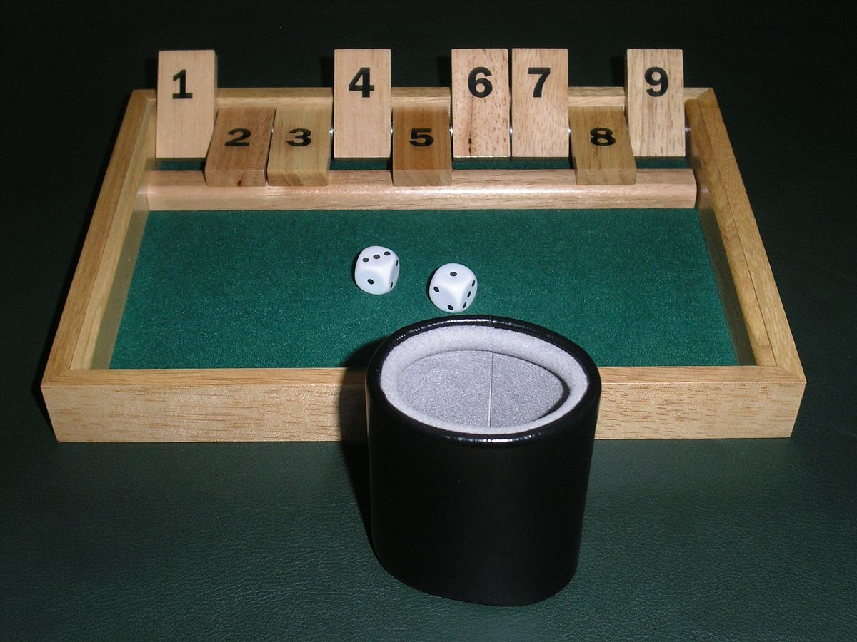
Shut the Box
Roll two dice and add the numbers indicated. You can then choose to close the total or any pair of digits that add to make that total.
For example, if you roll 2 and 5, you can choose to close 7 OR 2 and 5 OR 1 and 6 OR 3 and 4.
Continue until a player rolls a total and cannot close anymore of their numbers. Then the winner is the person who has the lowest score at the end of the game.

Slide 10

Roll 5 Dice
Can you use the digits to make all of the consecutive numbers from 1-21?
You DO NOT have to use all 5 digits every time.
You can use any of the four operations – addition, subtraction, multiplication and division.

Slide 11
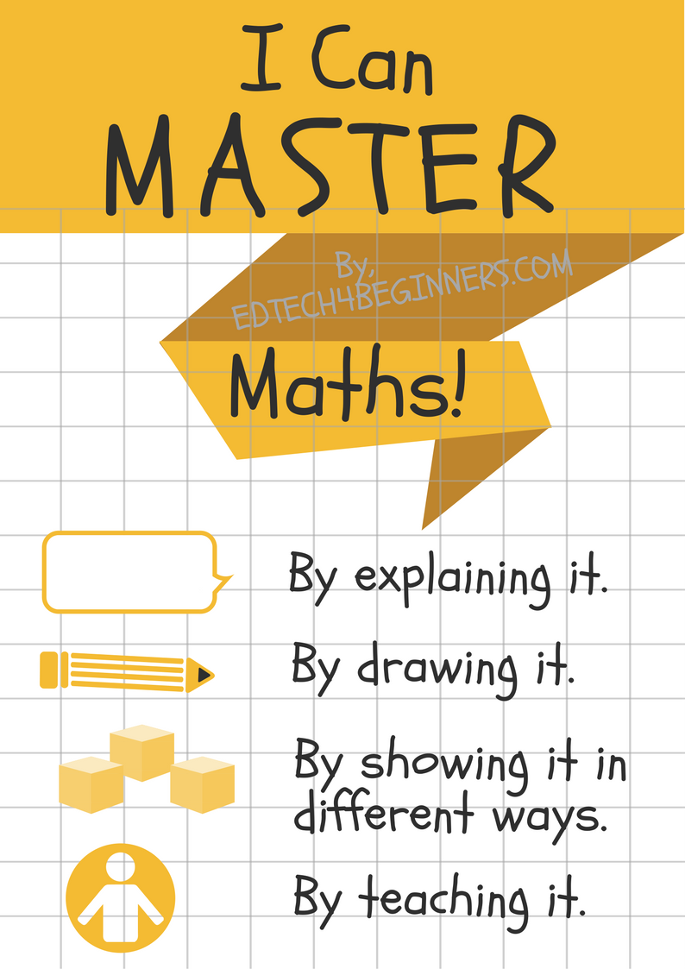
Go A.P.E.

Slide 12
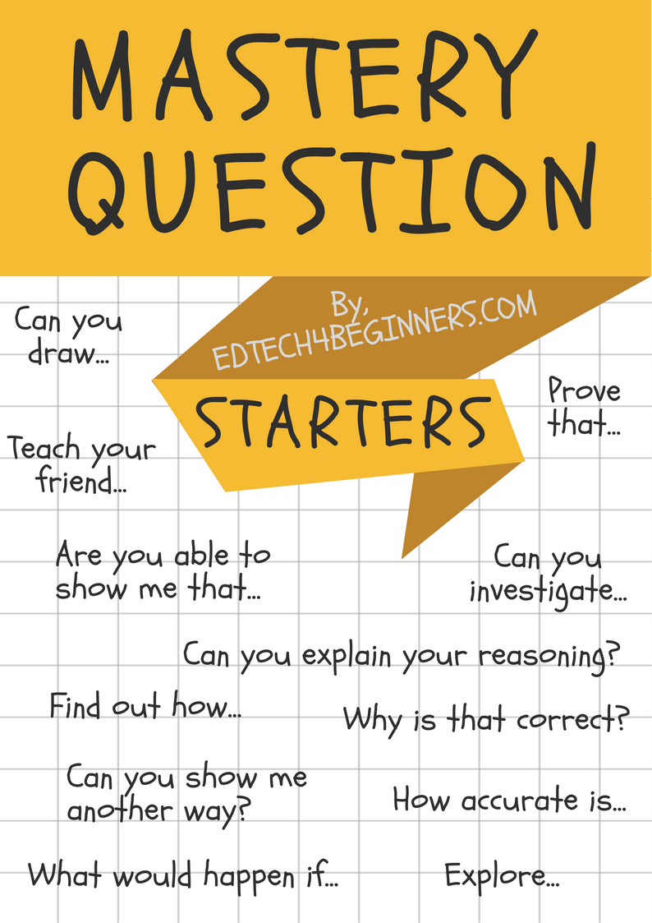

Slide 13
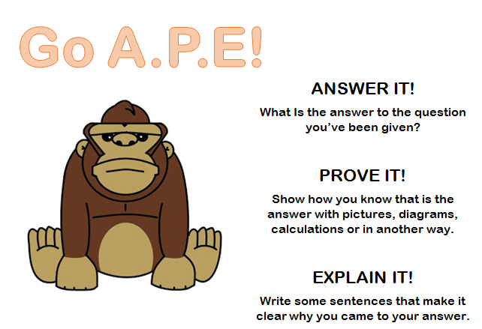

Slide 14
ANSWER IT!
True or False?
18÷6=3
What is the answer to the question you’ve been given?

Slide 15
PROVE IT!
How could we draw this calculation?
18÷6=3
Now you must use the manipulatives and draw a picture to PROVE the above calculation is true/false.

Slide 16
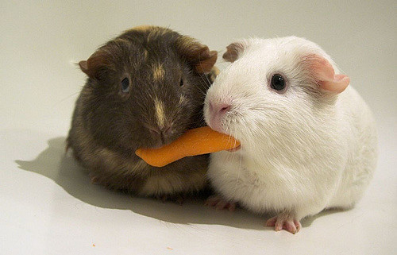
Sharing is caring!
Have a walk around the room and have a look at the different ways other groups have represented this calculation.
Did any of you have similar drawings?
Did you represent the calculation in different ways?
What did you learn?

Slide 17
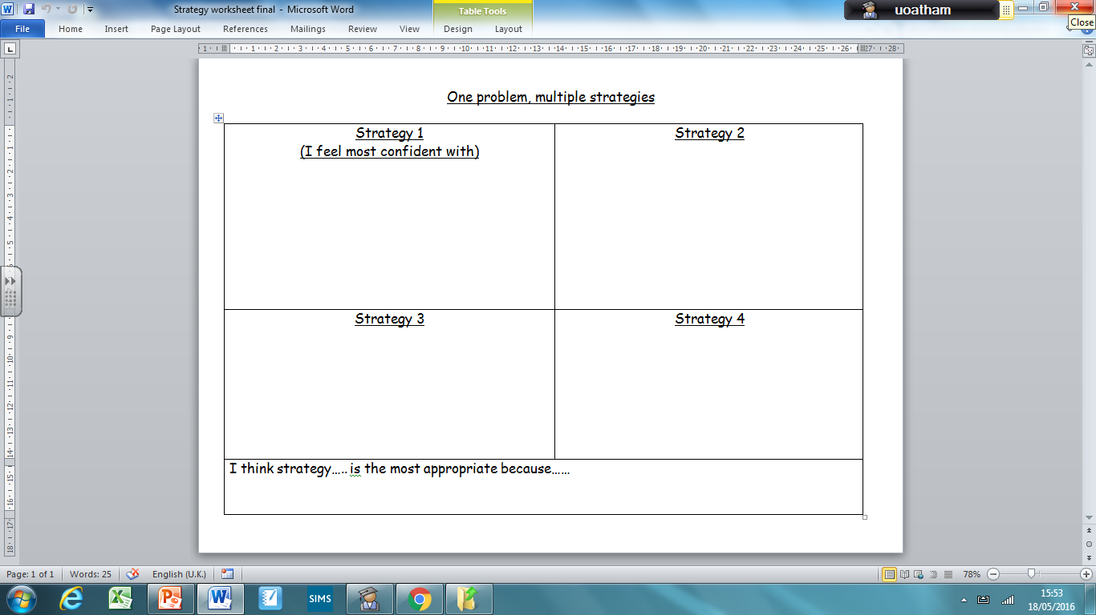
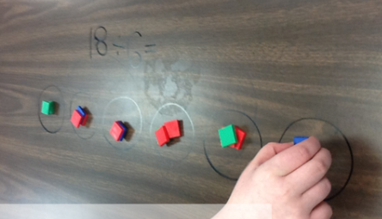

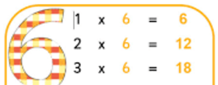
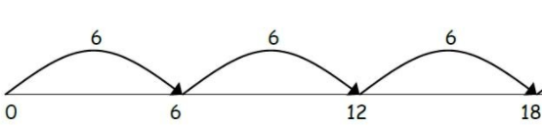

Slide 18
Finally, let’s EXPLAIN!
18÷6=3
Can your child verbalise and justify their thinking, following their exploration? This is the depth that we are talking about. Once you verbally explain your reasoning, can you record in words?

Slide 19
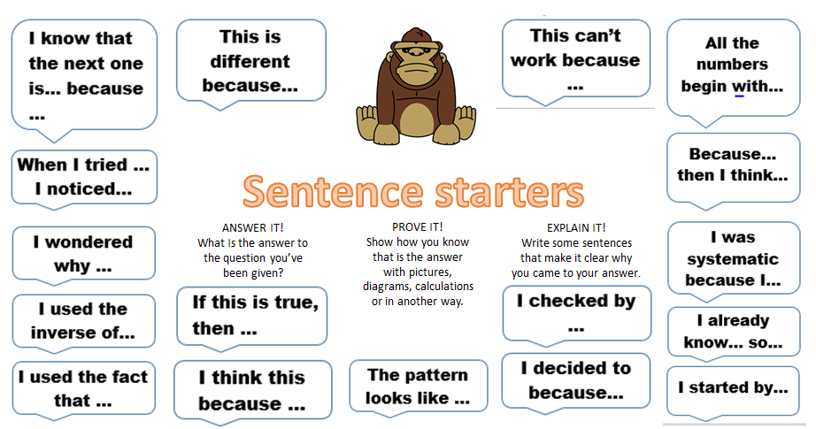

Slide 20
ANSWER IT!
Going a level deeper now. Slight tweak in question choice. Can you use your answer to the previous question to solve this calculation?
19÷6=

Slide 21
PROVE IT!
How could we draw this calculation?
19÷6=
Now you must use the manipulatives and draw a picture to PROVE your answer to this calculation is correct.

Slide 22

Sharing is caring!
Have a walk around the room.
Did any of you have similar drawings?
Did you represent the calculation in different ways?
What did you learn?

Slide 23
Finally, let’s
EXPLAIN IT!
19÷6= 3r1
.
This is the UNDERSTAND part of the session. Can your child verbalise and justify their thinking following their exploration? This is the depth that we are talking about.

Slide 25
Greater depth - Reasoning
This is an example of a question we would use to encourage children to go to greater depth with their new learning:
I have a remainder of 1 – what could the calculation have been?
Can you write another example? Can you write a word problem which would have a remainder of 1?

Slide 26
Some of our suggestions to encourage mathematical reasoning at home
See maths in everything!
Use any manipulatives possible at home: buttons, pegs, rulers, pasta, pebbles, pens - whatever you come across!
Draw diagrams to prove answers are correct
Have mathematical discussions – encourage your child to explain how they’ve answered a question and use mathematical language correctly to justify their thinking and try to explain why.
Encourage them to see maths as something that anyone can be good at.

Slide 27
Websites
There are various websites aimed at helping parents to support their children’s learning in maths.
• Oxford Owl has games, activities and a ‘jargon buster’ – http://www.oxfordowl.co.uk/for-home/maths-owl/maths
• National Numeracy Parent Toolkit has tips and advice for different age groups - http://www.nnparenttoolkit.org.uk/

Slide 28

Thank you so much for coming this morning.

