Slide 1
How to talk the times tables Y2 + KS2
Concept
There are 1,2,3,4,5,6,7,8,9,10,11,12 groups of (times tables – remains the same) There are ____ altogether
Recall – short form (sound bite)
One seven is/are seven - Two sevens are fourteen - Three sevens are twenty-one – etc
Recall - Step count
7,14,21,28…

Slide 2
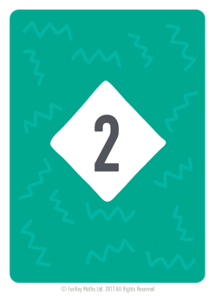
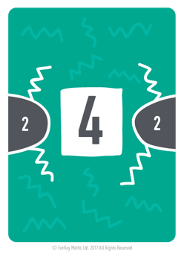
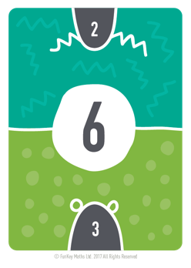
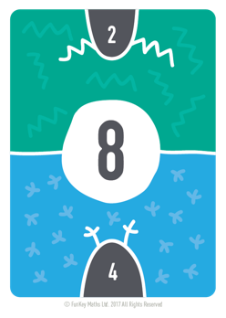
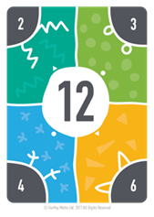
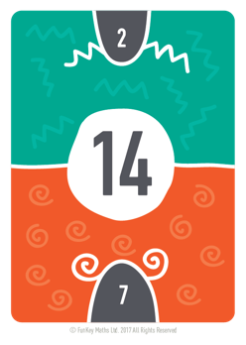
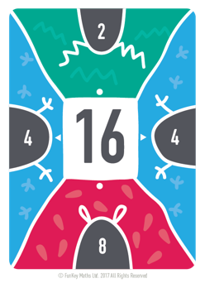
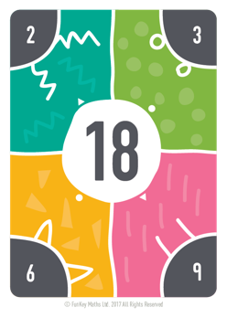
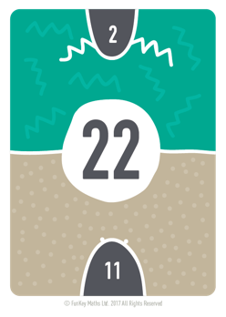
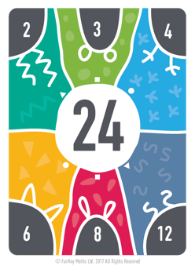
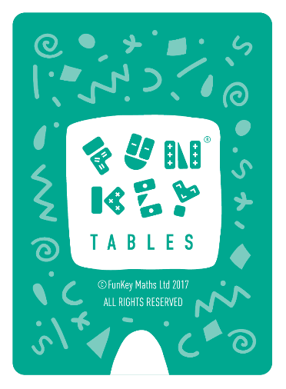
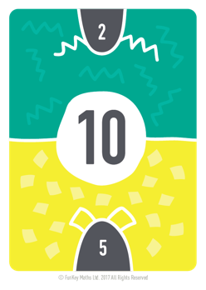
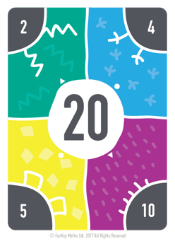
Step counting in 2s

Slide 3
Step counting in 2s

Slide 4
Step counting in 2s

Slide 5
Step counting in 2s

Slide 6
Step counting in 2s

Slide 7
Step counting in 2s

Slide 8
Step counting in 2s

Slide 9
Step counting in 2s

Slide 10
Step counting in 2s

Slide 11
Step counting in 2s

Slide 12
Step counting in 2s

Slide 13
Step counting in 2s

Slide 14
Step counting in 2s

Slide 15
How to talk the times tables Y2 + KS2
Concept
There are 1,2,3,4,5,6,7,8,9,10,11,12 groups of (times tables – remains the same) There are ____ altogether
Recall – short form (sound bite)
One seven is/are seven - Two sevens are fourteen - Three sevens are twenty-one – etc
Recall - Step count
7,14,21,28…

Slide 16
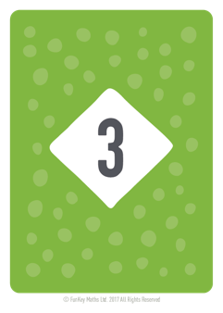
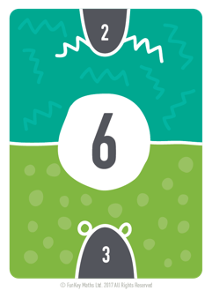
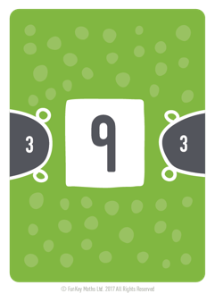
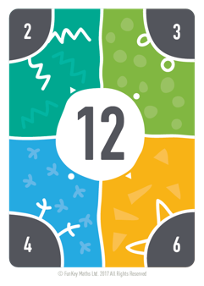
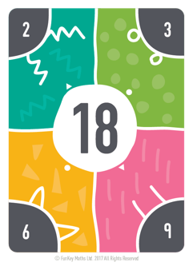
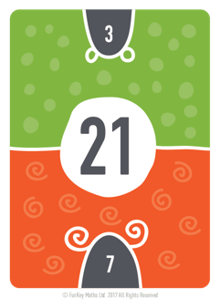
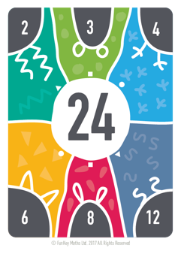
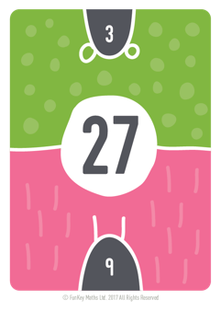
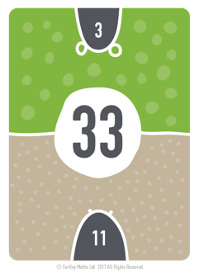
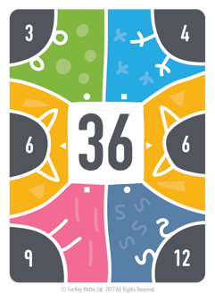
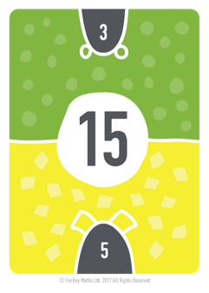
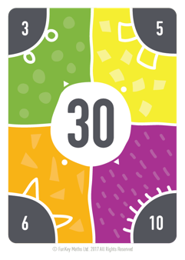
Step counting in 3s

Slide 17
Step counting in 3s

Slide 18
Step counting in 3s

Slide 19
Step counting in 3s

Slide 20
Step counting in 3s

Slide 21
Step counting in 3s

Slide 22
Step counting in 3s

Slide 23
Step counting in 3s

Slide 24
Step counting in 3s

Slide 25
Step counting in 3s

Slide 26
Step counting in 3s

Slide 27
Step counting in 3s

Slide 28
How to talk the times tables Y2 + KS2
Concept
There are 1,2,3,4,5,6,7,8,9,10,11,12 groups of (times tables – remains the same) There are ____ altogether
Recall – short form (sound bite)
One seven is/are seven - Two sevens are fourteen - Three sevens are twenty-one – etc
Recall - Step count
7,14,21,28…

Slide 29
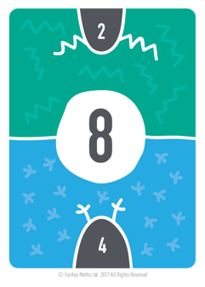
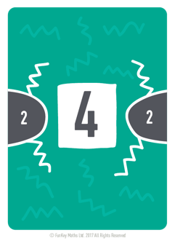
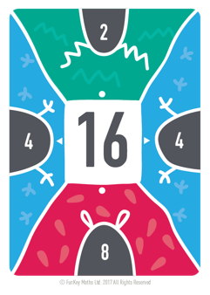
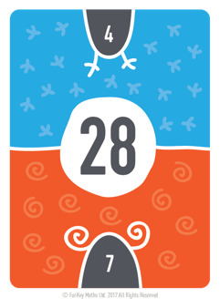
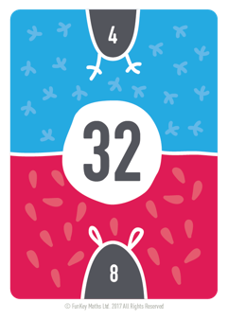
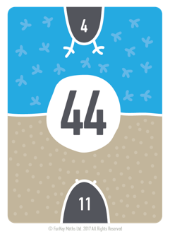
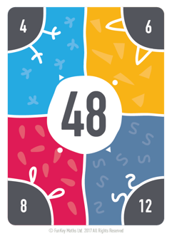
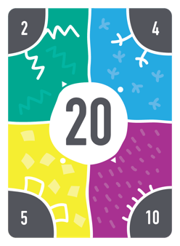
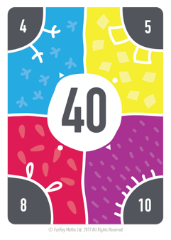
Step counting in 4s

Slide 30

Step counting in 4s

Slide 31
Step counting in 4s

Slide 32
Step counting in 4s

Slide 33
Step counting in 4s

Slide 34
Step counting in 4s

Slide 35
Step counting in 4s

Slide 36
Step counting in 4s

Slide 37
Step counting in 4s

Slide 38
Step counting in 4s

Slide 39
Step counting in 4s

Slide 40
Step counting in 4s

Slide 41
Step counting in 4s

Slide 42
How to talk the times tables Y2 + KS2
Concept
There are 1,2,3,4,5,6,7,8,9,10,11,12 groups of (times tables – remains the same) There are ____ altogether
Recall – short form (sound bite)
One seven is/are seven - Two sevens are fourteen - Three sevens are twenty-one – etc
Recall - Step count
7,14,21,28…

Slide 43


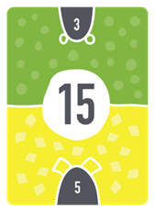

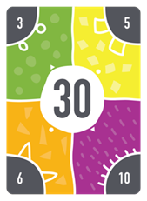
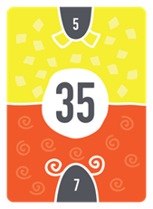
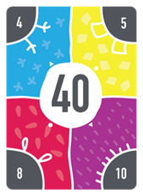
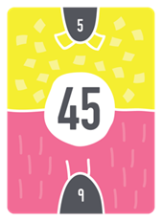
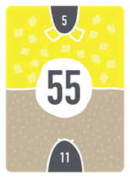
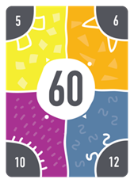
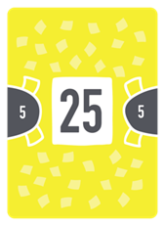
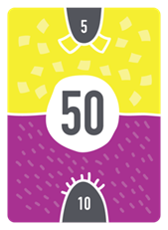
Step counting in 5s

Slide 44
Step counting in 5s

Slide 45
Step counting in 5s

Slide 46
Step counting in 5s

Slide 47
Step counting in 5s

Slide 48
Step counting in 5s

Slide 49
Step counting in 5s

Slide 50
Step counting in 5s

Slide 51
Step counting in 5s

Slide 52
Step counting in 5s

Slide 53
Step counting in 5s

Slide 54
Step counting in 5s

Slide 55
Step counting in 5s

Slide 56
How to talk the times tables Y2 + KS2
Concept
There are 1,2,3,4,5,6,7,8,9,10,11,12 groups of (times tables – remains the same) There are ____ altogether
Recall – short form (sound bite)
One seven is/are seven - Two sevens are fourteen - Three sevens are twenty-one – etc
Recall - Step count
7,14,21,28…

Slide 57
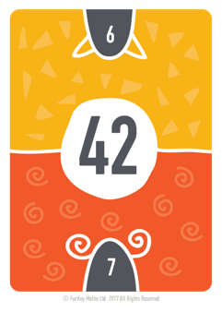
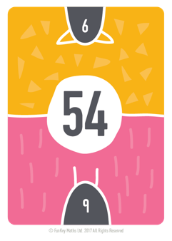
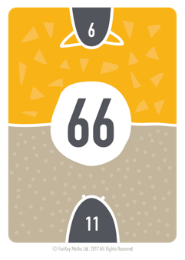
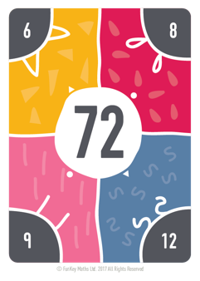
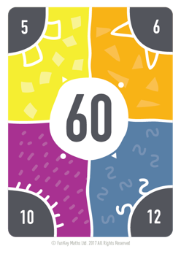
Step counting in 6s

Slide 58
Step counting in 6s

Slide 59
Step counting in 6s

Slide 60
Step counting in 6s

Slide 61
Step counting in 6s

Slide 62
Step counting in 6s

Slide 63
Step counting in 6s

Slide 64
Step counting in 6s

Slide 65
Step counting in 6s

Slide 66
Step counting in 6s

Slide 67
Step counting in 6s

Slide 68
Step counting in 6s

Slide 69
How to talk the times tables Y2 + KS2
Concept
There are 1,2,3,4,5,6,7,8,9,10,11,12 groups of (times tables – remains the same) There are ____ altogether
Recall – short form (sound bite)
One seven is/are seven - Two sevens are fourteen - Three sevens are twenty-one – etc
Recall - Step count
7,14,21,28…

Slide 70

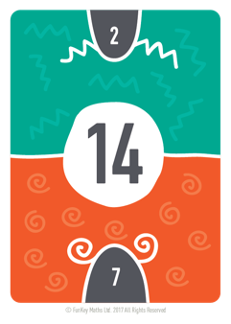
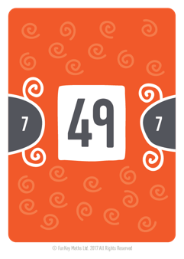






Step counting in 7s

Slide 71
Step counting in 7s

Slide 72
Step counting in 7s

Slide 73
Step counting in 7s

Slide 74
Step counting in 7s

Slide 75
Step counting in 7s

Slide 76
Step counting in 7s

Slide 77
Step counting in 7s

Slide 78
Step counting in 7s

Slide 79
Step counting in 7s

Slide 80
Step counting in 7s

Slide 81
Step counting in 7s

Slide 82
Step counting in 7s

Slide 83
How to talk the times tables Y2 + KS2
Concept
There are 1,2,3,4,5,6,7,8,9,10,11,12 groups of (times tables – remains the same) There are ____ altogether
Recall – short form (sound bite)
One seven is/are seven - Two sevens are fourteen - Three sevens are twenty-one – etc
Recall - Step count
7,14,21,28…

Slide 84





Step counting in 8s

Slide 85
Step counting in 8s

Slide 86
Step counting in 8s

Slide 87
Step counting in 8s

Slide 88
Step counting in 8s

Slide 89
Step counting in 8s

Slide 90
Step counting in 8s

Slide 91
Step counting in 8s

Slide 92
Step counting in 8s

Slide 93
Step counting in 8s

Slide 94
Step counting in 8s

Slide 95
Step counting in 8s

Slide 96
Step counting in 8s

Slide 97
How to talk the times tables Y2 + KS2
Concept
There are 1,2,3,4,5,6,7,8,9,10,11,12 groups of (times tables – remains the same) There are ____ altogether
Recall – short form (sound bite)
One seven is/are seven - Two sevens are fourteen - Three sevens are twenty-one – etc
Recall - Step count
7,14,21,28…

Slide 98





Step counting in 9s

Slide 99
Step counting in 9s

Slide 100
Step counting in 9s

Slide 101
Step counting in 9s

Slide 102
Step counting in 9s

Slide 103
Step counting in 9s

Slide 104
Step counting in 9s

Slide 105
Step counting in 9s

Slide 106
Step counting in 9s

Slide 107
Step counting in 9s

Slide 108
Step counting in 9s

Slide 109
Step counting in 9s

Slide 110
Step counting in 9s

Slide 111
How to talk the times tables Y2 + KS2
Concept
There are 1,2,3,4,5,6,7,8,9,10,11,12 groups of (times tables – remains the same) There are ____ altogether
Recall – short form (sound bite)
One seven is/are seven - Two sevens are fourteen - Three sevens are twenty-one – etc
Recall - Step count
7,14,21,28…

Slide 112






Step counting in 10s

Slide 113

Step counting in 10s

Slide 114
Step counting in 10s

Slide 115
Step counting in 10s

Slide 116
Step counting in 10s

Slide 117
Step counting in 10s

Slide 118
Step counting in 10s

Slide 119
Step counting in 10s

Slide 120
Step counting in 10s

Slide 121
Step counting in 10s

Slide 122
Step counting in 10s

Slide 123
Step counting in 10s

Slide 124
How to talk the times tables Y2 + KS2
Concept
There are 1,2,3,4,5,6,7,8,9,10,11,12 groups of (times tables – remains the same) There are ____ altogether
Recall – short form (sound bite)
One seven is/are seven - Two sevens are fourteen - Three sevens are twenty-one – etc
Recall - Step count
7,14,21,28…

Slide 125






Step counting in 11s

Slide 126
Step counting in 11s

Slide 127
Step counting in 11s

Slide 128
Step counting in 11s

Slide 129
Step counting in 11s

Slide 130
Step counting in 11s

Slide 131
Step counting in 11s

Slide 132
Step counting in 11s

Slide 133
Step counting in 11s

Slide 134
Step counting in 11s

Slide 135
Step counting in 11s

Slide 136
Step counting in 11s

Slide 137
Step counting in 11s

Slide 138
How to talk the times tables Y2 + KS2
Concept
There are 1,2,3,4,5,6,7,8,9,10,11,12 groups of (times tables – remains the same) There are ____ altogether
Recall – short form (sound bite)
One seven is/are seven - Two sevens are fourteen - Three sevens are twenty-one – etc
Recall - Step count
7,14,21,28…

Slide 139




Step counting in 12s

Slide 140
Step counting in 12s

Slide 141
Step counting in 12s

Slide 142
Step counting in 12s

Slide 143
Step counting in 12s

Slide 144
Step counting in 12s

Slide 145
Step counting in 12s

Slide 146
Step counting in 12s

Slide 147
Step counting in 12s

Slide 148
Step counting in 12s

Slide 149
Step counting in 12s

Slide 150
Step counting in 12s

Slide 151
Step counting in 12s

