Slide 1
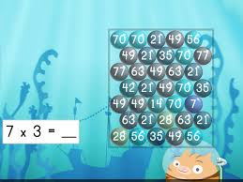
Times Tables Workshop
7th February 2019

Slide 2
National Curriculum times tables expectations:
By the end of Y2: children have to know x10, x2 & x5 tables.
By the end of Y4: children have to know all times tables to 12x12.
Years 5 and 6: Recall multiples of 12 in any order, including missing numbers and related division facts fluently.
Years 5 and 6: Recall multiples of all times tables up to 12x12 in any order, including missing numbers and related division facts with growing fluency.

Slide 3

Why do children need to know times tables?
❑ Multiplication
❑ Division
❑ Fractions
❑ Decimals
❑ Perimeter
❑ Area
❑ Ratio
❑ Proportion
❑ Problem Solving

Slide 4
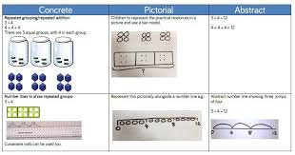
Calculation Policy
Let’s have a look at how we teach multiplication in school and the progression through the methods

Slide 5
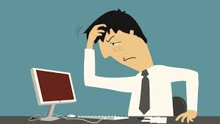
How can we help our children learn multiplication facts?
I’m sure we all remember standing up, chanting tables at school
Learning by rote is one strategy, but there are also other activities we can do with children to help them learn their tables.

Slide 6
Language of multiplication
product divide
times half
double array
multiple sets of
multiplied by factors
groups of repeated addition

Slide 7
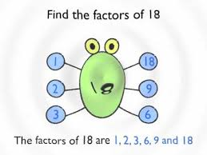
Factor
One number is a factor of another number if it divides into it exactly

Slide 8
Groups of/ lots of/ sets of
3 groups of 5 are 15,
3 lots of 5 are 15,
3 sets of 5 are 15
3 x 5 = 15

Slide 9
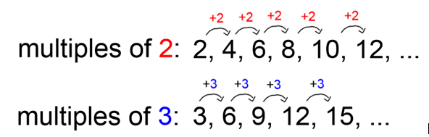
Multiple
These are the numbers that you find in the times tables

Slide 10
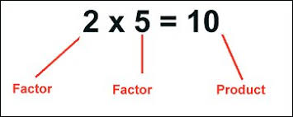
Product
A product is the answer you get when you multiply two or more numbers together

Slide 11
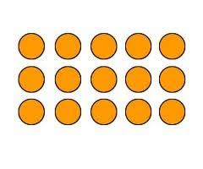
Array
An array is a visual representation of a multiplication
Shown are 5 columns of 3 with 15 in total
So 5 x 3 = 15

Slide 12
Looking for patterns
Being able to spot patterns in numbers is an important skill and can also help with learning tables. Children can investigate these multiplication rules:
Odd number x odd number = odd number (E.g. 3 x 5 = 15)
Even number x even number = even number (E.g. 4x 6 = 24)
Odd number x even number = even number (E.g. 3 x 6 = 18)

Slide 13
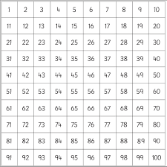
Finding patterns
Colour multiples on a 100 square

Slide 14
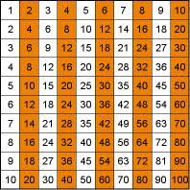
Patterns with multiples
Writing statements

Slide 15

Tips and Tricks x4
To multiply by 4 we can double and double again:
EXAMPLE 6 x 4 = 
Double 6 is 12
Double 12 is 24
So 6 x 4 = 24

Slide 16
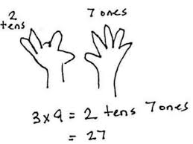
Tips and Tricks x9
Works for up to 10 x 9
Put the finger down for the multiple, e.g. 3 for 3 x 9.
The fingers to the left of the put down finger are the tens (2), the fingers to the right are the ones (7)
3 x 9 = 27

Slide 17
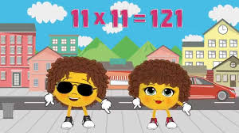
11 x A Lovely Pattern
1 X 11 = 11
2 X 11 = 22
3 X 11 = 33
4 X 11 = 44
5 X 11 = 55
6 X 11 = 66
7 X 11 = 77
8 X 11 = 88
9 X 11 = 99

Slide 18
Start with the easiest tables and work up
10 x tables very young children will quickly grasp this pattern
5x tables we can use our hands and it has a lovely pattern ending in 5 or 0
2x tables finding pairs and doubling
4x table double the 2x tables
9x tables these have nice shortcuts
3x 6x you can double the 3x to get the 6x tables

Slide 19
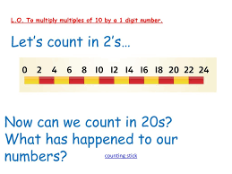
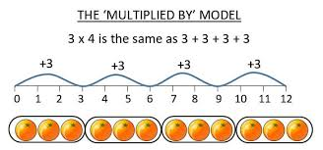
Models and Images
At school this might include counting multiples on a counting stick and repeated addition with a number line.

Slide 20

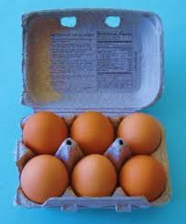
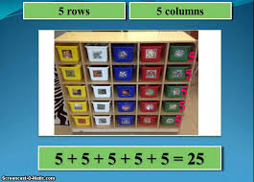
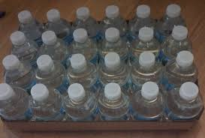
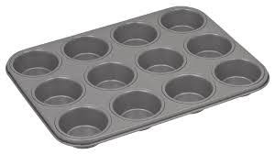
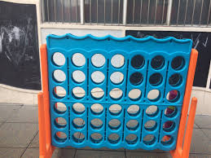
Looking for arrays

Slide 21



Times tables at home
Try using the repeated number line (lots of) method to help your child understand their times tables
Make memory links
Look for patterns
Play games e.g. bowling, card games
Ict games
Songs

Slide 22

Use the varied language of multiplication
e.g. 7x8
Seven eights
Seven times eight
Seven multiplied by eight
The product of seven and eight
Seven groups of eight
Eight lots of 7

Slide 23

Useful Websites
Woodlands Junior http://www.woodlands.kent.sch.uk/
Ictgames http://www.ictgames.com/
maths is fun (good website for definitions) www.mathsisfun.com
sumdog (free to join, great games) www.sumdog.com
BBC Bitesize maths www.bbc.com/bitesize/subjects/zjxhfg8

Slide 24

Remember…
Like any skill if times tables are not used regularly they can get forgotten.
When your child has mastered a times table it is important to keep practising.
Don’t let them get rusty!

Slide 25
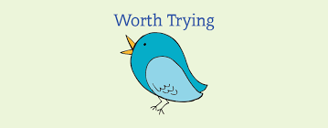
Any questions?
Thank you for attending today.
What are you going to try?

