Slide 1
Oracy- The ability to communicate effectively!
Do you talk to your child at every opportunity?
Do you share news and events?
Do you introduce your child to new and exciting words? Children love big words!
Can they re-tell stories to you?
Can your child begin to reason and justify? Do you have simple debates with them. “Which is better, sunshine or rain?”
When you talk as a family encourage them to take their turn to speak and listen to what others say too.
At EP Collier we want all members of our school community have the skills to communicate effectively so that they have a voice, are listened to and feel valued, both within school and in their lives ahead.

Slide 2
How does Early Years Foundation Stage (EYFS) fit in?
Primary School
Nursery or Pre-School ages 3-4yrs (EYFS)
Reception Year ages 4-5 yrs “Starting School” (EYFS)
Year 1/2 (Key Stage 1)
Year 3/4 and Year 5/6 (Key Stage 2)
Secondary School
Years 7-11 (Key Stages 3 & 4)

Slide 3
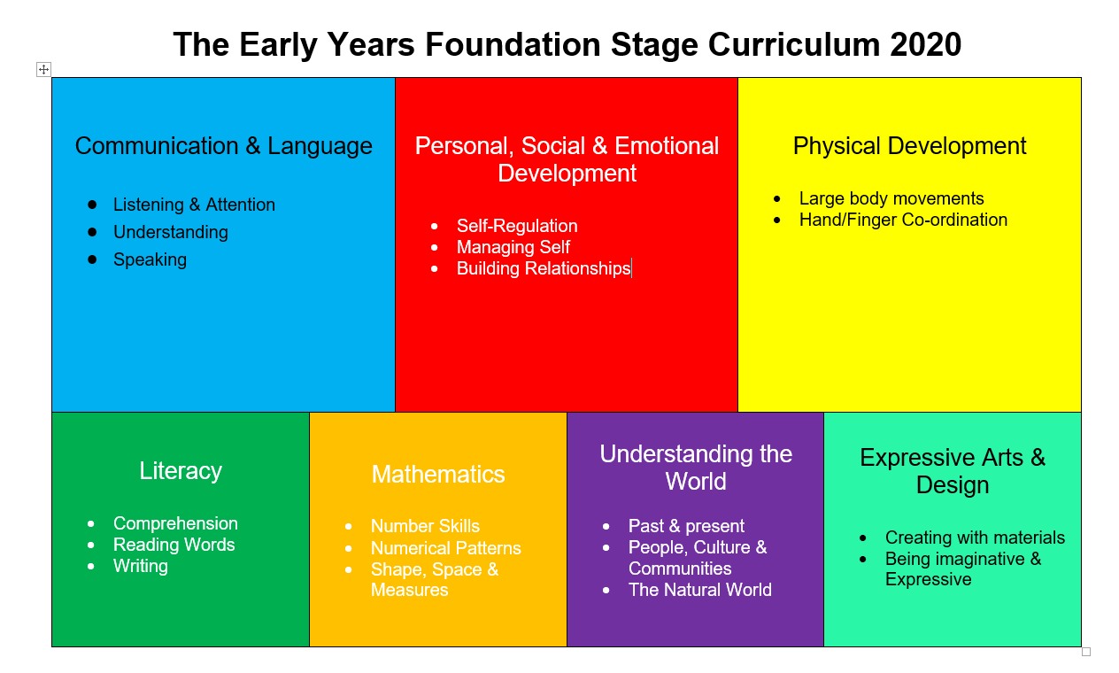

Slide 4

Learning in the Early Years is a balance of..
Adult Directed and Child Initiated Activities
Inside and Outside Play
Play based activities and more formal learning.
This balance shifts as the year progresses.
Sept……………………………………………………………………. July
Formal Learning
Play Based Learning

Slide 5


What does learning look like in EYFS?
Child Initiated Learning Play | Adult Directed Learning Play or More Formal Learning
Carefully set up environment with a range of opportunities that reflect the adult directed learning happening with the teachers Lots of different areas of play (Role play, painting, sand/water, mark making, imaginative play, physical challenge) Child initiates their own play, guided, supported and extended by the trained early years practitioners | Daily input on the carpet to introduce new knowledge, themes and discussion Daily Phonics sessions Daily Maths Session Other directed learning sessions in small groups (Eg. writing, learning to share, language development) Reading & Story Sessions Rhymes/Poetry

Slide 6
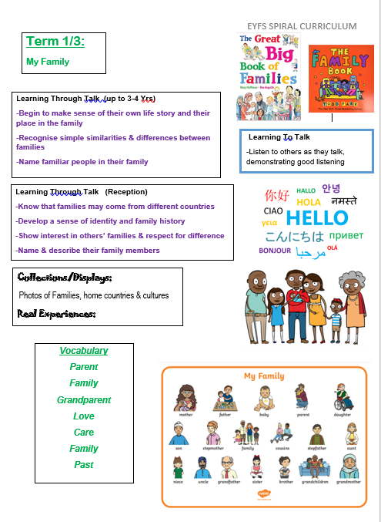
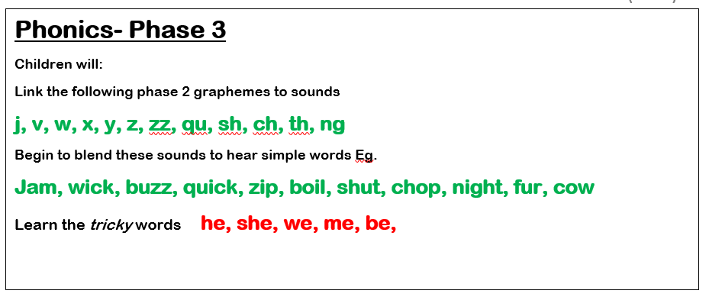
Weekly Learning Organisers

Slide 7
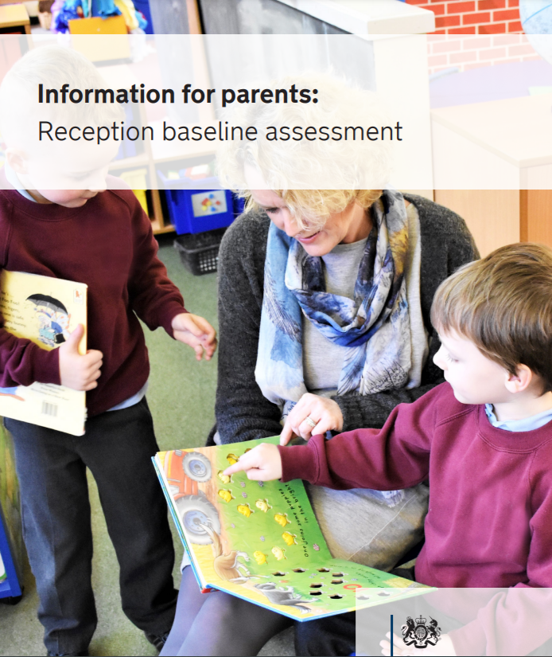
Reception Baseline Assessment (RBA)
Video Information
https://www.youtube.com/watch?v=qlJFl8NJwe8&t=18s
https://www.gov.uk/government/publications/reception-baseline-assessment-information-for-parents

Slide 8

Communicating With Parents
Regular updates via email to share achievements, progress and concerns
Photographs so you can see what they have been doing at school
Information about your child’s next steps and targets
Tips on ways to help your child at home with these
10 minute Parent Appointments twice a year – November and April
Annual School Report- July

Slide 9





Reading
Please try and read every night with your child.
Little and often is the key to engaging young readers!

Slide 10




Each week your child will bring home…
2x reading books chosen by the teacher
1x library book chosen by the child to share at home
Learning to Read
Reading Scheme Books. Child reads the book for themselves with someone else listening & supporting
Books For Pleasure
Someone reads with or to the child….

Slide 11

Reading
It is expected that the child will read each book 2/3 times at home
Talk about the story, characters, events & new words
Practise working out the words using the sounds
Reading for fluency and meaning, trying out expression
Repeating & mastering a book will create a more confident, motivated reader!

Slide 12
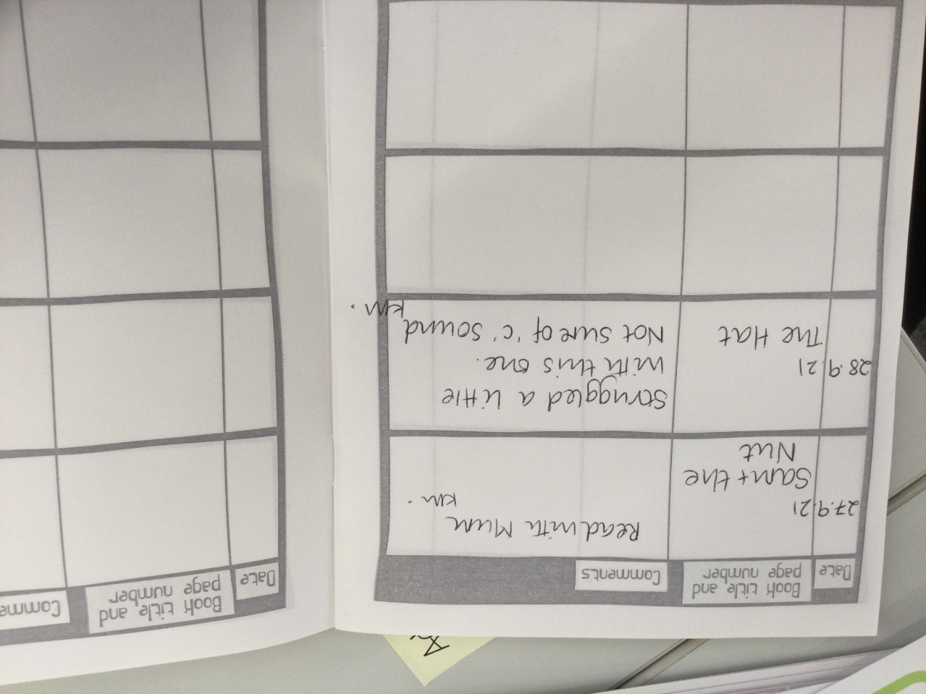
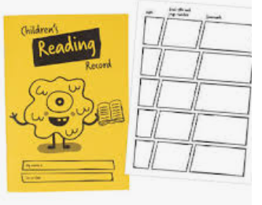
Reading at Home Diaries
Please record every time your child reads to you at home. You are welcome to comment if you wish.

Slide 13

Library Sessions
Please look after our books!
Children will be introduced to the Library
They will start bringing books home after the half term
Library books will be chosen by the children themselves and so may be of varying abilities
This book is for you and your child to share together and not necessarily for them to read themselves
Please help your child to remember to bring their book back each week

Slide 14

Teaching & Supporting Reading
Workshop for Parents
Further information to follow…

Slide 15
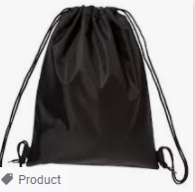

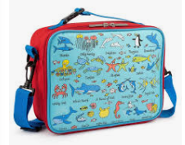

Please remember the following…
 | Nursery 12.15-3.15pm | Reception 8.40-3.00 pm
Leave In School | -Drawstring bag with spare clothes | -Drawstring bag with spare clothes (if needed) PE Kit
Everyday | -Warm & waterproof coat -Water bottle optional | -Warm & waterproof coat -Reading Book Bags -Lunchbag (or order lunch online) -Water bottle optional
Sport/PE |  | Please remove/cover all earrings and jewellery & avoid tights! We will let you know which day your class will have PE
Library Book | - | We will let you know which day to bring the book back
Please avoid bringing bags/rucksacks-we do not have space in our cloakrooms

Slide 16
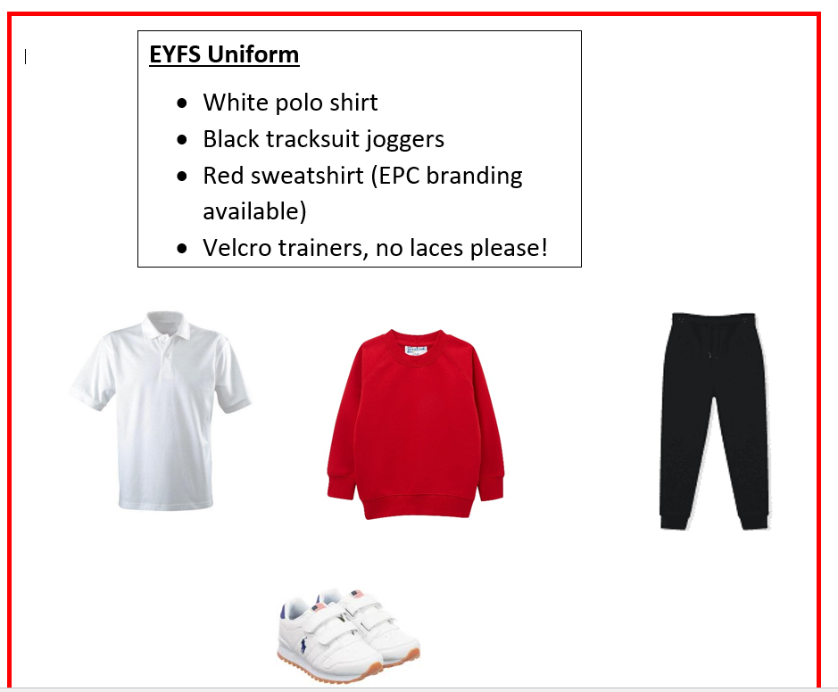
EYFS Uniform

Slide 17
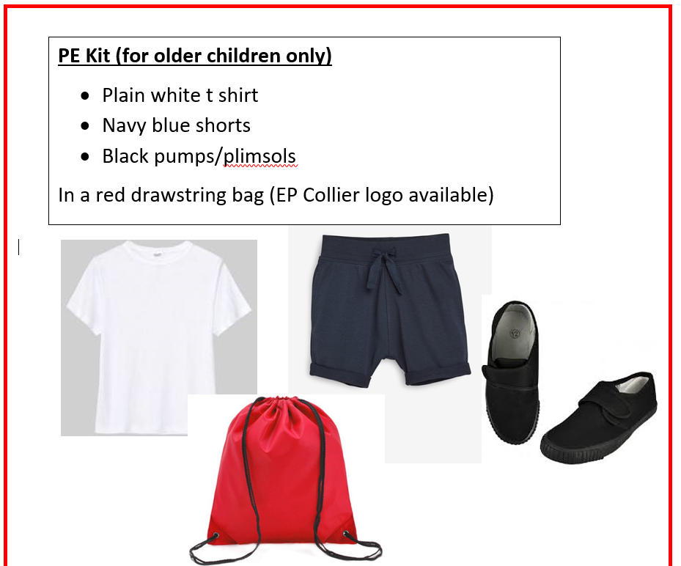
PE / Sport Kit
(Reception only)

Slide 18


Lunches (for Reception) please encourage independent eating!
Healthy packed lunch from home (no nuts, fizzy drinks sweets or chocolate) or
School Dinner (Free and ordered in advance online) www.parentpay.com/
Please do not send snacks

Slide 19

Useful Reference
Our School website
https://www.epcollier.reading.sch.uk/
Helping your child to make the correct letter sounds
https://www.youtube.com/watch?v=TkXcabDUg7Q
www.wordsforlife.org.uk for recommended books to read with your child at different ages
Preparing your child for school
https://www.bbc.co.uk/cbeebies/grownups/how-to-prepare-your-child-for-primary-school

Slide 20

Top Tips for learning
Talk to your child at EVERY opportunity!
Share books and stories EVERY day
Teach them songs and rhymes
Remember to keep using your home language
Use letter sounds not letter names when reading/spelling
(b not “bee”) see video link
Please use lower case letters not capitals c g h k
https://www.epcollier.reading.sch.uk/
Remember to make learning fun….little and often

Slide 21
Oracy- The ability to communicate effectively!
Do you talk to your child at every opportunity?
Do you share news and events?
Do you introduce your child to new and exciting words? Children love big words!
Can they re-tell stories to you?
Can your child begin to reason and justify? Do you have simple debates with them. “Which is better, sunshine or rain?”
When you talk as a family encourage them to take their turn to speak and listen to what others say too.
At EP Collier we want all members of our school community to have the skills to communicate effectively so that they have a voice, are listened to and feel valued, both within school and in their lives ahead.

