Slide 1

Starting Nursery at
EP Collier 2023

Slide 2

Introductions
Headteacher: Mrs McMinn
Deputy Head: Ms Barnett
EYFS Lead: Ms Lee
Nursery Staff: Miss Smith & Miss Knight (Class Teachers) supported by Mrs Kayani (Early Years Practitioner)
Miss Gillanders is our Inclusion Manager and oversees the support for children who have special needs.
Other agencies that work alongside us include the School Nursing Team, Speech & Language Therapists, Educational Psychologist and other specialist support services.

Slide 3

The Characteristics of Effective Learning
Playing and exploring – engagement
Finding out and exploring
Playing with what they know
Being willing to ‘have a go’
Active learning – motivation
Being involved and concentrating
Keeping trying
Enjoying achieving what they set out to do
Creating and thinking critically – thinking
Having their own ideas
Making links between their learning experiences
Choosing new ways to do things/problem solving

Slide 4
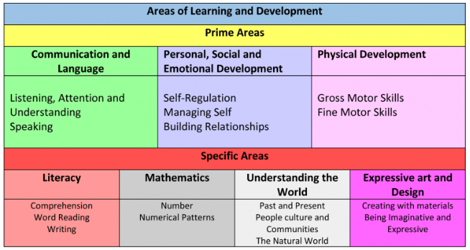

Slide 5

Nursery at EP Collier
12:15pm – 3.15pm
Please arrive promptly for the beginning of the session and be here ready for collection at the end of the session.
Learning and exploring free flow inside and outside.
A mix of child initiated and adult directed learning.
We provide water, milk and a fruit/vegetable snack.

Slide 6
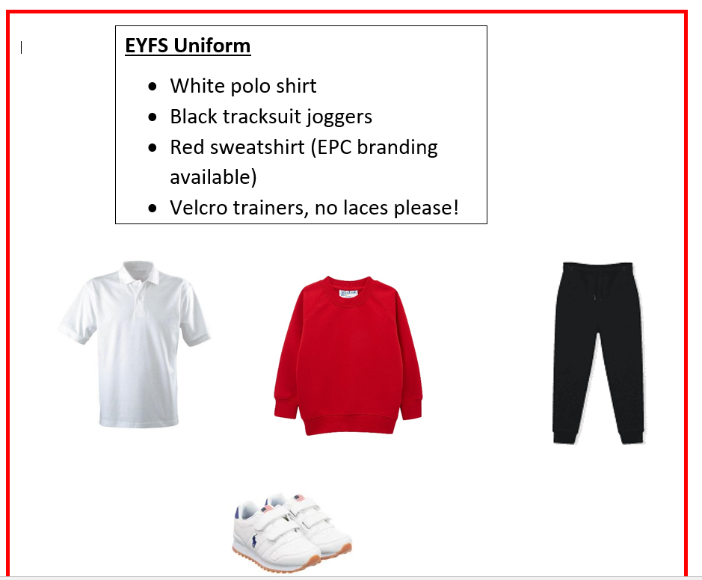

Slide 7
What should my child bring to nursery?
- Warm waterproof coat
- Water bottle (water only please)
- bookbag
-spare set of clothes to leave at school (in named bag)
PLEASE NAME ALL ITEMS!

Slide 8


Transition Arrangements
Thursday 5^{th –} Tuesday 10th September:
10 minute 1:1 meetings with teacher
Wednesday 11th September: 1 hour stay and play session with parents
Thursday 12th – Wednesday 18th September: Start nursery in small groups
Wednesday 18th September: whole class

Slide 9

Things to do at home
Read to your child or share books EVERYDAY
Talk to your child at every opportunity
Share rhymes & songs
Please use lower case letters f h k t
Use letter sounds not letter names
Speak in your home language
Be positive and make learning fun!

Slide 10

How can I help?
BE POSITIVE & EXCITED FOR YOUR CHILD!
PLEASE help your child to…
Be independent
Take shoes on & off and put coats on
Recognise their name
Use the toilet independently
Ask for help from an adult
Share the Transition Booklet with your child
Remember early nights!

Slide 11


EP Collier website
Children’s Booklet to download from website

Slide 12

Practical Help
EP Collier website: www.epcollier.reading.sch.uk
Check Parent boards in playground
Open door policy: Talk to staff at the beginning/end of the day
Reporting absence Tel: 9375470
Uniform: Available https://www.pbuniform-online.co.uk/epcollier

