Slide 1
Sports Assembly
Thursday 6th September 2018
Mr Gardner

Slide 2
SPORTS SUPER STARS!
The sport superstar awards have been created to celebrate those children in the school that have worked incredibly hard to develop these following skills:
Good communication with their team mates and teachers
Shown good ball control, racket skills and spatial awareness when playing competitive games
A willingness to learn and learn from mistakes
Shown fair play in games and supported their peers in succeeding
Taking and giving positive constructive feedback
Competing in competitions and representing the school

Slide 3
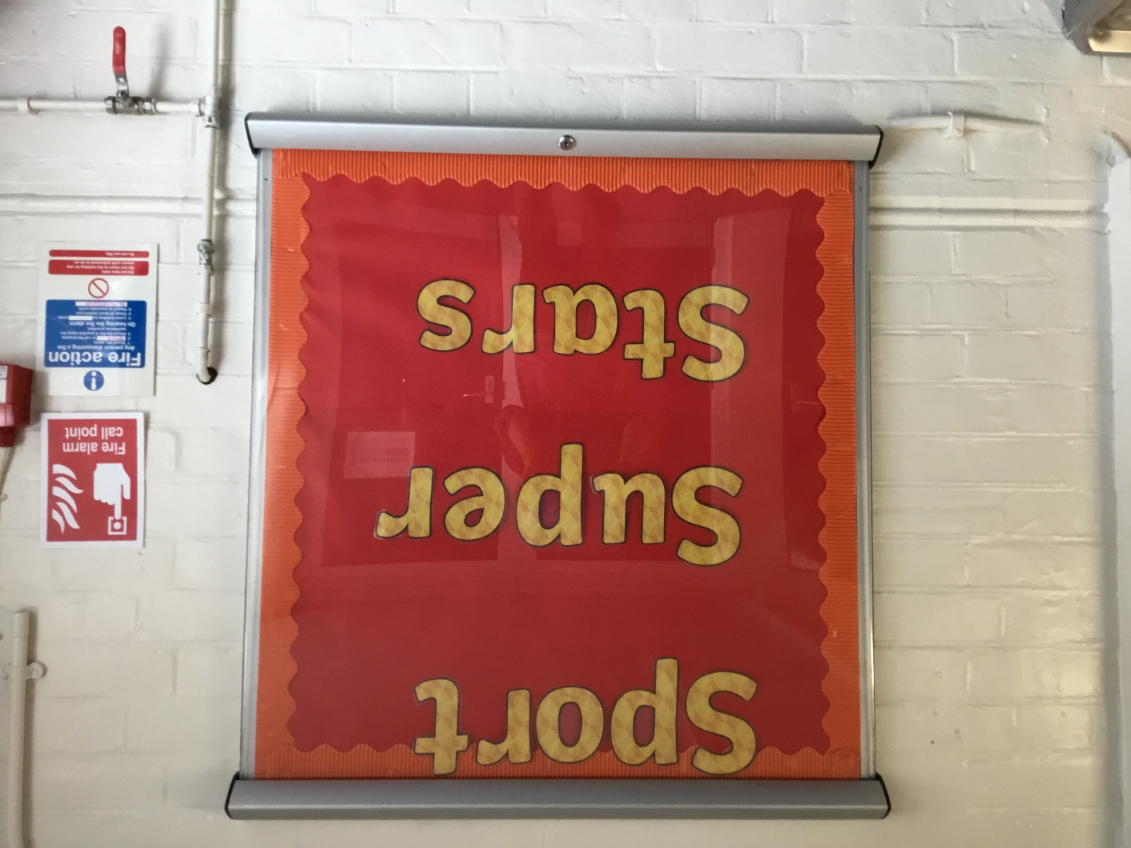
Sport Super Star Display
Sport superstars will be displayed for everyone to see for a whole term.
Next term, there will be more sport superstars added.
Will it be you?
What are you going to do differently in your P.E. Lessons to win the award?

Slide 4
What are we looking for?
In the Playground
Children playing kindly and being supportive of others.
Showing good sportsmanship when playing games
Sharing play equipment outside
Respecting all adults at lunchtime
In our P.E. Lessons
Using the skills that you have learnt in competitive games
Communicating well with your team mates and your teacher
Using the P.E. Equipment well
Using skills that you have learnt in extra-curricular activities to enhance your game play.

Slide 5
Sports Events at E.P. Collier
Basketball League Starts
Football League Starts
October ‘18
Crossfields football
October ‘18
Y5&6 Mixed Hockey @ Highdown
October ‘18
Y3&4 Mixed Football
September ‘18
JMA Junior Cross Country
September ‘18

Slide 6
Lunchtimes at E.P. Collier
New Line Markings
Reading Rockets
Reading Football Club
Performance Sports – Multi Skills

Slide 7
I can’t wait to see who will be the next E.P. Collier Sport Superstars & Sports ambassadors!

