Slide 1

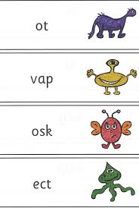
Welcome to our information talk on the
Phonics Screening Check

Slide 2
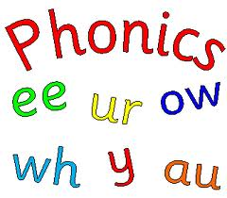
What is phonics?
Phonics is a way of teaching children to read quickly and skilfully. They are taught how to:
  recognise the sounds that each individual letter makes;
  identify the sounds that different combinations of letters make - such as ‘sh’ or ‘oo’; and
  blend these sounds together from left to right to make a word.
Children can then use this knowledge to ‘blend’ the sounds in to a word.
This is the first important step in learning to read.

Slide 3
At EP Collier
Phonics takes place every day for 20 minutes daily
Children are grouped according to their knowledge of sounds known.
We follow the LCP planning based on the Letters and Sound Documment.

Slide 4
What is the Phonics Screening Check?
The Phonics Screening Check is a statutory assessment that started in 2012.
All children in Year 1 must be tested.
Any Year 2 children who did not pass in the previous year will be retested.
The Phonics Screening Check will take place during the week Monday 11 June to
Friday 15 June 2018
The check is designed to confirm whether individual children have learnt phonic decoding to an appropriate standard.

Slide 5
The Results
Pass mark will not be given with the check materials.
The pass mark will be available on Monday 25 June 2018 after the check has taken place.

Slide 6
What the phonics screening check will look like
The check will include a ten page booklet with four words on each page.
The check contains 40 words divided into two sections of 20 words.
Each page will contain either four pseudo-words or four real words.

Slide 7
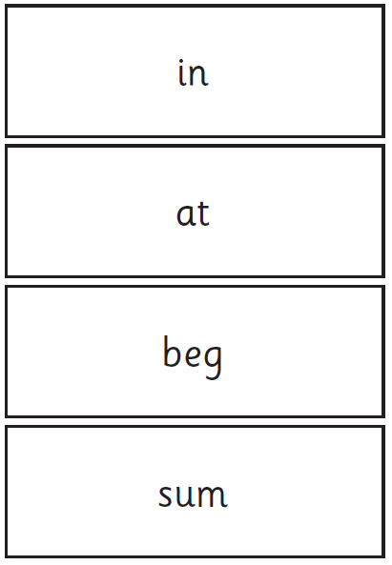
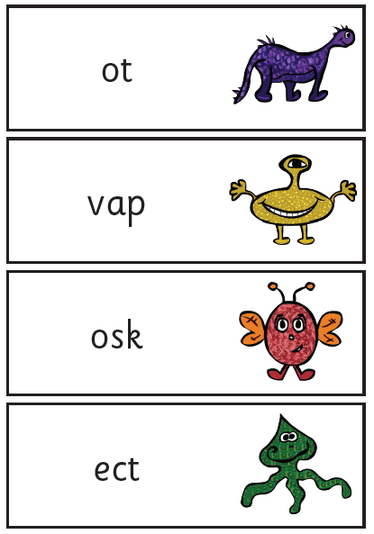
What is the Phonics screening check?

Slide 8

The two sections
Section 1
• sounds that are usually introduced first to children and are quite simple such as cat, shin including non sense words like hild.
Section 2
• sounds that are usually introduced later to children and include sounds such as ‘oo’, ‘ay’ For example, book, zoo, portrait and fape

Slide 9
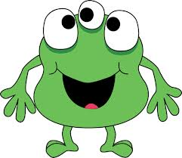
Pseudo-words/real words
Pseudo words are ‘fake’ words.
Each pseudo word will be accompanied by a picture of an imaginary creature.
The picture is used to provide a context for the word they are being asked to decode.

Slide 10
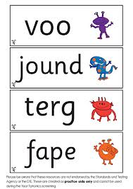
Why pseudo words are used
Using pseudo-words allows the assessment to focus purely on decoding using phonics.
As pseudo-words are new to all children, they do not favour children with a good vocabulary knowledge or large visual memory of words.

Slide 11

How long the check will take
There is no time limit for the check. The children can take as long as they like.
During the phonic checks that took place last year, we found that most children took approximately 10 minutes.
For those children who can not concentrate for long periods, the check can be broken up into short periods and administered over a period of time.

Slide 12
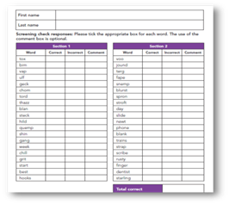
Scoring the check
The child will work one-to-one with a familiar teacher.
The child will work through each word in order.
The teacher will record whether the child has said the word correctly or not.
A score is awarded.
Parents will be informed of this as part of the end of year report they receive.
Notes:
Show answer sheet

Slide 13
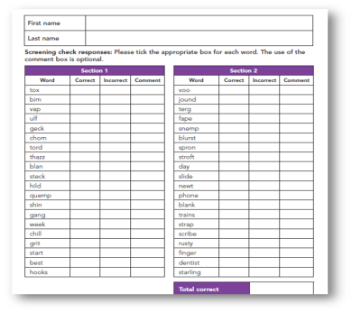
My child has not met the required standard
If your child has not met the expected standard by the end of Year 1, then they will retake the test in the June of Year 2 (2019).
If your child is in Year 2 and they do not pass for the second time, they will not have to retake the test in Year 3.
However they will be monitored by the Key Stage Lead and Phonic Lead to ensure they achieve the expected standard.
Notes:
Pass mark last year 32 , this may change this year.

Slide 14

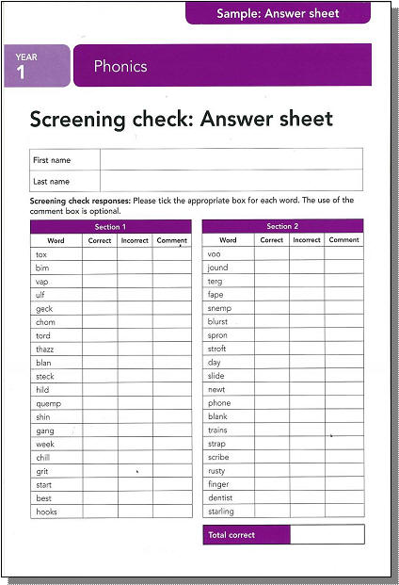
What happens to the results
The school is required to report the results to the Local Authority
Children identified as not having met the required standard will be highlighted for phonics support work .

Slide 15
Last years results
2016
60% of children passed the Phonics Screening Check in Year.
2017
69% of children passed the Phonics Screening Check in Year 1.

Slide 16



At EP Collier ….
We monitor and assess the children regularly.
We provide children with additional support.
Phonics related homework to reinforce the learning.

Slide 17

How you can help
Helping your child with phonics
  Phonics works best when children are given plenty of encouragement and learn to enjoy reading and books. Parents play a very important part in helping with this.
Some simple steps to help your child learn to read through phonics:
● You can highlight sounds when you read with your child.
● Teaching how sounds match with letters starts with individual letters such as ‘s’, ‘a’ and ‘t’ and then moves on to two-letter sounds such as ‘ee’, ‘ch’ and ‘ck’.

Slide 18


With all books, encourage your child to ‘sound out’ unfamiliar words and then blend the sounds together from left to right rather than looking at the pictures to guess.
Once your child has read an unfamiliar word, you can talk about what it means and help him or her to follow the story.
Most of the books your child takes home are ‘decodable’ books which means they can sound out and blend unfamiliar words.
Try to make time to read with your child every day. Grandparents and older brothers or sisters can help too. Encourage your child to blend the sounds all the way through a word.

Slide 19
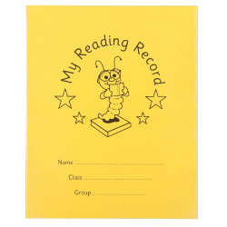
Word games like ‘I-spy’ can also be an enjoyable way of teaching children about sounds and letters. You can also encourage your child to read words from your shopping list or road signs to practise phonics.
The reading record is a good way to let your child’s teacher know if they have any difficulties or have enjoyed the book. There are activities in the reading dairy which encourage children to share what they have learnt and enjoyed.

Slide 20
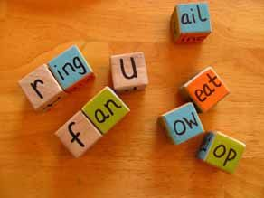
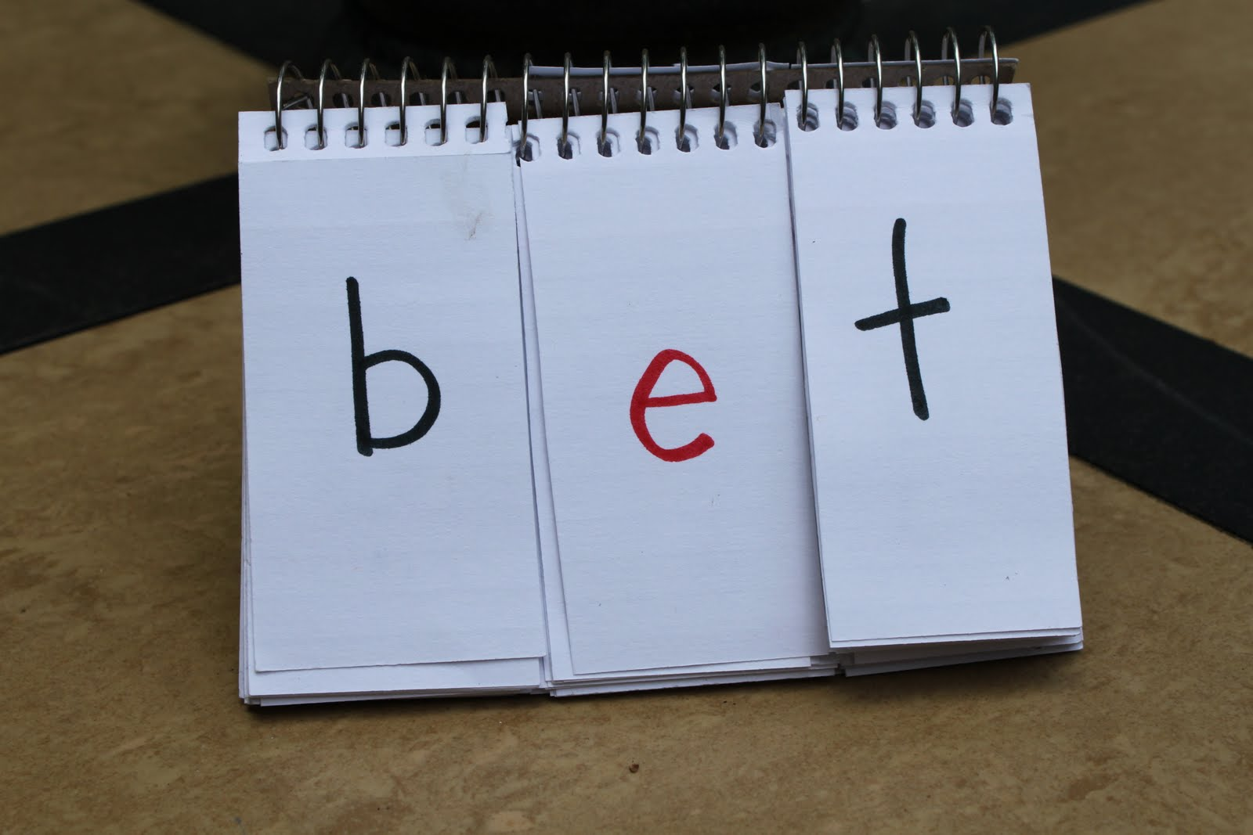
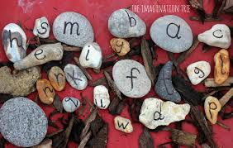

Slide 21
Resources to support at home
https://www.youtube.com/watch?v=BqhXUW_v-1s
Demonstrates how to articulate the phonemes.
www.phonicsplay.co.uk
Has a variety of free phonics resources for your child to play. These games include both pseudo and real words.
www.ictgames.com
The Literacy section has games for all different levels of ability.
www.letters-and-sounds.com
More online resources.

