Slide 1
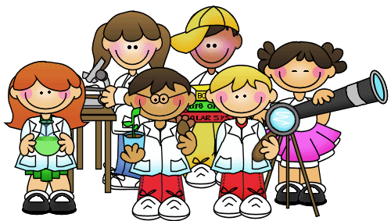
Science at EP Collier
By the end of the workshop you will:
•Be aware of the primary science National Curriculum requirements
•Understand how we teach science at EP Collier
•Know how to support and develop your child’s scientific knowledge and interest

Slide 2
The National Curriculum aims for all children:
To develop scientific knowledge and conceptual understanding through the specific disciplines of chemistry, physics and biology.
To develop understanding of the nature, processes and methods of science through questioning and enquiry.
To equip all children with scientific knowledge required to understand uses and implications of science today and for the future.

Slide 3
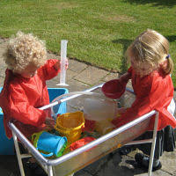
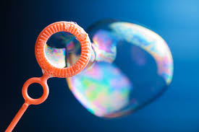
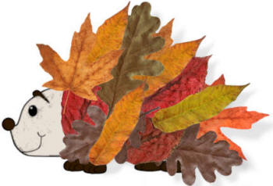
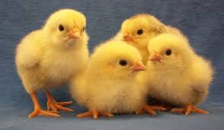
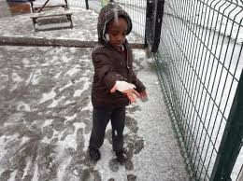
Foundation Stage
Children know about similarities and differences in relation to places, objects, materials and living things. They talk about the features of their own immediate environment and how environments might vary from one another. They make observations of animals and plants and explain why some things occur, and talk about changes.
Adults set up environments, interact with children and observe learning. Predominantly child led learning.

Slide 4
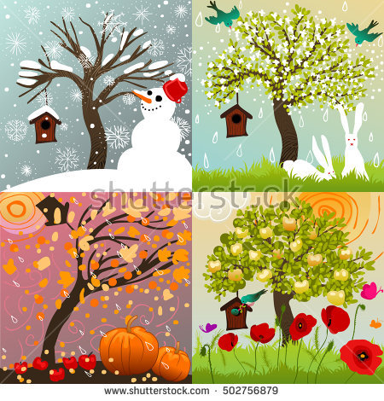
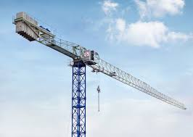
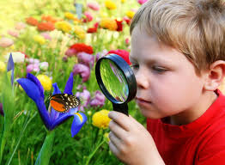
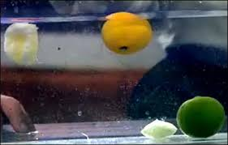
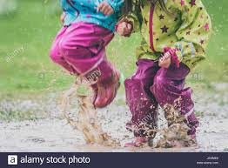
KS1 Years 1&2
Focus upon experiencing and observing phenomena. Looking more closely at natural and man-made environment.
Be curious and ask questions .

Slide 5
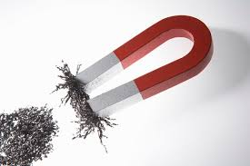
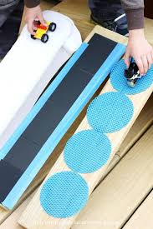
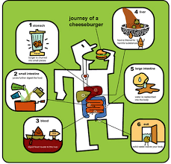
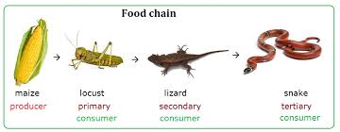
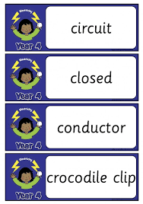
Lower KS2 Years 3&4
Focus upon enabling pupils to broaden their scientific view of the world.
Exploring, talking about, testing and developing ideas, questioning
Changes over time, noticing patterns, grouping, classifying, simple comparative and fair tests, develop use of scientific language and use of secondary sources of information

Slide 6
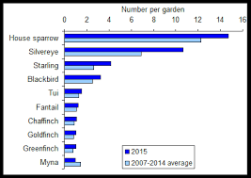
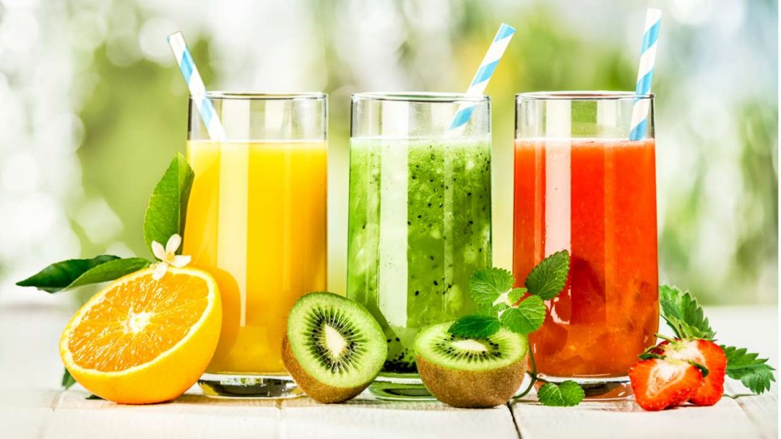
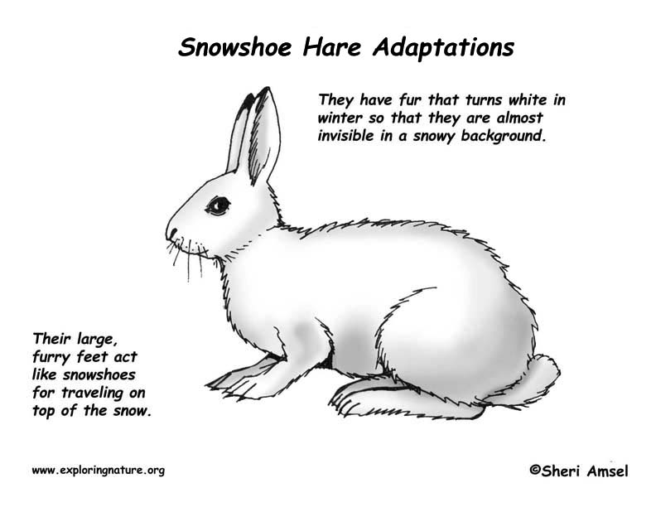
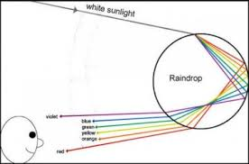
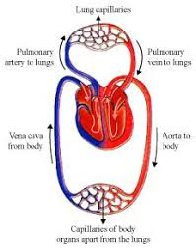
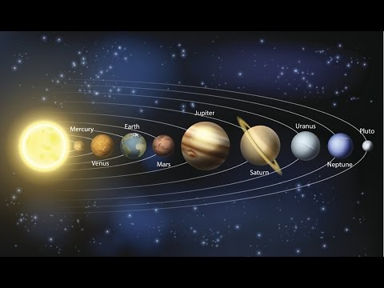
Upper KS2 Years 5&6
Focus upon enabling pupils to develop a deeper understanding of a wide range of scientific ideas.
Exploring, talking about, testing and developing ideas, questioning
Analysing functions, relationships and interactions more systematically. Recognise that scientific ideas change and develop over time.
Select appropriate ways to try and answer questions, use different methods of scientific enquiry. Justify their answers and draw conclusions.
Use a wide range of secondary sources of information.

Slide 7
 | Term 1 | Term 2 | Term 3 | Term 4 | Term 5 | Term 6
EYFS | Understanding the World • Making observations • Using the senses • Representing real life • Asking questions • Making predictions • Sharing knowledge • Recognising patterns and change • Caring for the environment
Year 1 | Our Changing World – Changes we notice across the seasons | Plant Detectives – recognising and naming common flowering plants and trees | Everyday Materials – comparing and naming every day materials |  | Looking at Animals – naming and grouping common animals | Using Senses – the basic parts of the human body associated with the senses
Year 2 | Our Changing World: Habitats- living and non-living things | Take Care – what our bodies need to be healthy | Growing Up – babies to adults | Apprentice Gardener –growing seeds | Materials- Good Choices Suitability of everyday materials | Materials Shaping Up –squashing, bending, twisting and shaping
Year 3 | Our Changing World – scientific enquiry | The Power of Forces – movement and magnets | Amazing Bodies – skeletons, muscles, nutrition | Rock Detectives – rocks, soil, fossils | How Does Your Garden Grow – parts and functions of flowering plants | Can You See Me?- light
Year 4 | Who am I? Our Changing World –classification of living things | Where does all the food go? – digestive system | Human Impact – food chains | In a State – solids, liquids and gases | Switched On – simple circuits, electrical items | Good Vibrations - Sound
Year 5 | Life Cycles – mammals, amphibians, insects and birds | Reproduction –some plants and animals | The Earth and Beyond The sun, moon and planets |  | Materials – Solids, liquids and gases | Feel the Force – gravity, resistance and friction, levers, pulleys and gears
Year 6 | Animals and Habitats - adaptation | Micro-organisms Classification of plants and animals | Light up Your World How light travels, how we see | Danger! Low Voltage How components within a circuit function | Evolution Processes that lead to the evolution of a species | Circulatory System Functions of heart, blood vessels and blood. Impact of life style upon how our bodies function

Slide 8

Working Scientifically
Children are taught practical scientific methods, processes and skills
Questioning
Observation
Testing and measuring (repeating)
Identifying and classifying
Recording data
Comparing
Predicting
Concluding
Explaining

Slide 9
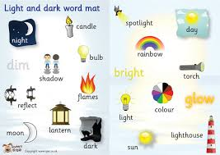
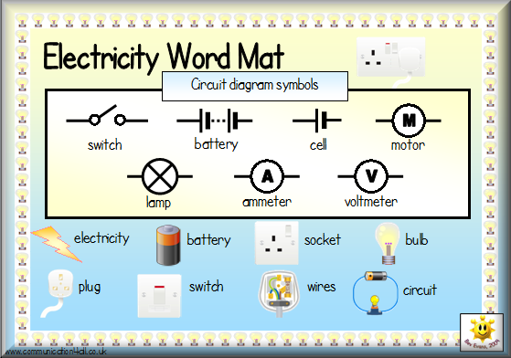
Scientific Vocabulary

Slide 10
Supporting Your Child

Slide 13
Common Misconceptions
Any Questions?

