Slide 1


Year 5 and 6 UKS2

Slide 2
Meet the Team
Year 5
Raven: Mr Hearfield and Mrs Farooq
Kestrels: Mrs Fox and Mrs Farooq
Year 6
Swans: Ms Ahmed and Mrs Dinakarain
Eagles: Miss Dass and Ms Stewart

Slide 3

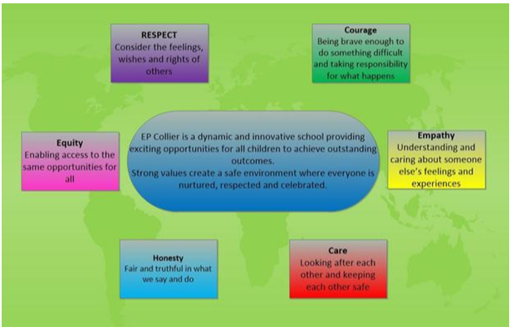
Expectations for UKS2
We expect children to:
respect and care for others
be punctual – school starts at 8.30am, register taken at 8.40am.
wear the correct uniform
follow the school rules
value and take responsibility for the school environment
We’ll help children to:
build on their self esteem
become confident in speaking out in class
gain the desire to work hard and succeed
respond proactively to adult advice and feedback
begin to take responsibility for their own learning

Slide 4

Curriculum for UKS2
• Reading
• Writing
• SPaG
• Maths
• Science
• Foundation subjects
• PE
• SATs (Year 6)
• How to support your child

Slide 5
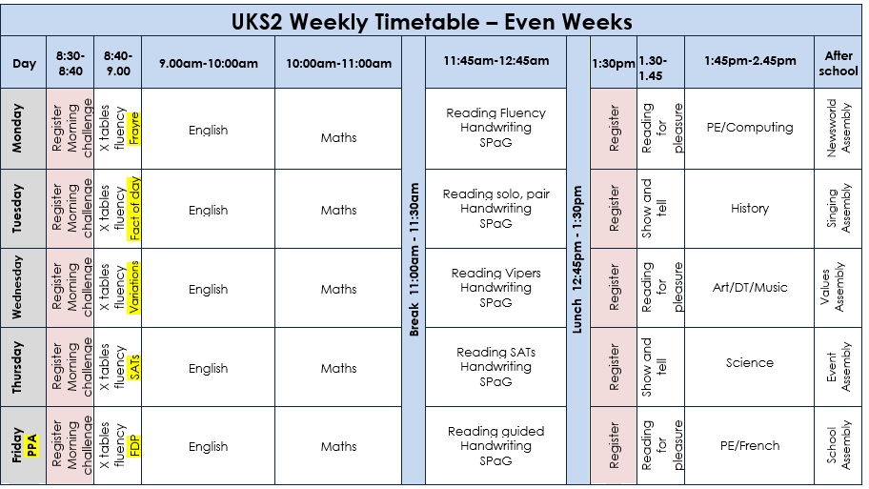


Slide 6


Phonics
•Daily Read Write Inc phonics lessons for children who need them.
•Racing to English inline with the phonics programme for a bridge of fluency and comprehension activities before moving into Whole Class Reading lessons.
Whole class reading
•5 x 60-minute lessons per week
•Vocabulary, fluency reading strategies (echo, coral, independent), text discussion and reading for pleasure.
•A combination of questions and activities to explore the text with a termly focus on one skill.
•1 minute read practice to develop understanding with speed.

Slide 7

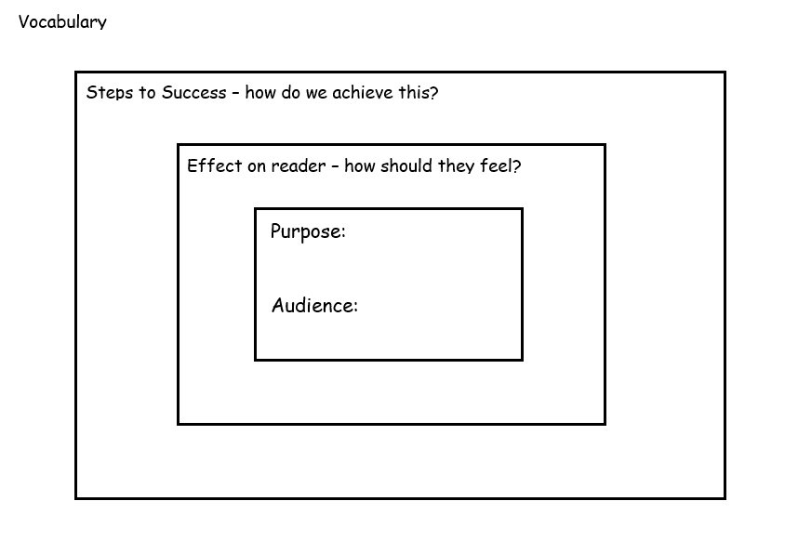
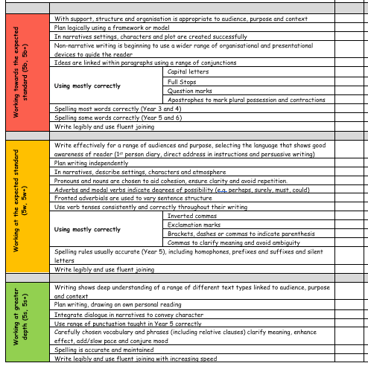
Year 5 writing Assessment

Slide 8
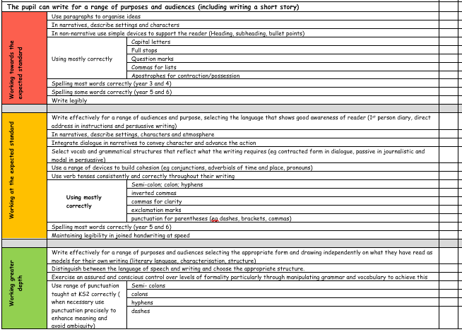
Year 6 writing Assessment

Slide 9
Spelling Rules Taught Across Year 5 and Year 6
Endings which sound like /ʃəs/spelt –cious or–tious
Endings which sound like /ʃəl/
Words ending in –ant,–ance/–ancy,–ent,–ence/–ency
Words ending in –able and –ible
Words ending in –ably and –ibly
Adding suffixes beginning with vowel letters to words ending in –fer
Words with the /i:/ sound spelt ei after c
Words containing the letter-string ough
Words with ‘silent’ letters (i.e. letters whose presence cannot be predicted from the pronunciation of the word)
Homophones and other words that are often confused

Slide 10
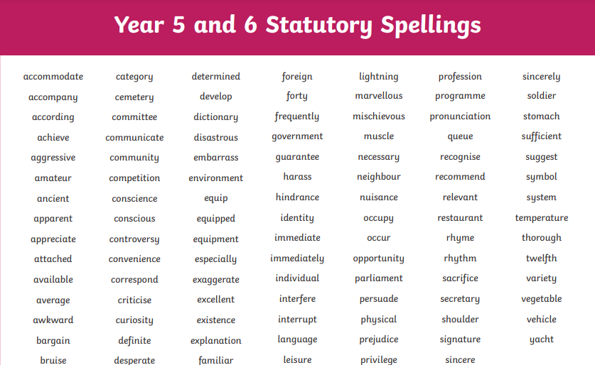

Slide 11
E P Collier Website
https://www.epcollier.reading.sch.uk/year-56-1/

Slide 12
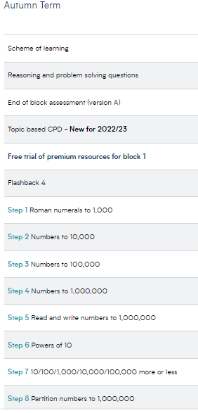

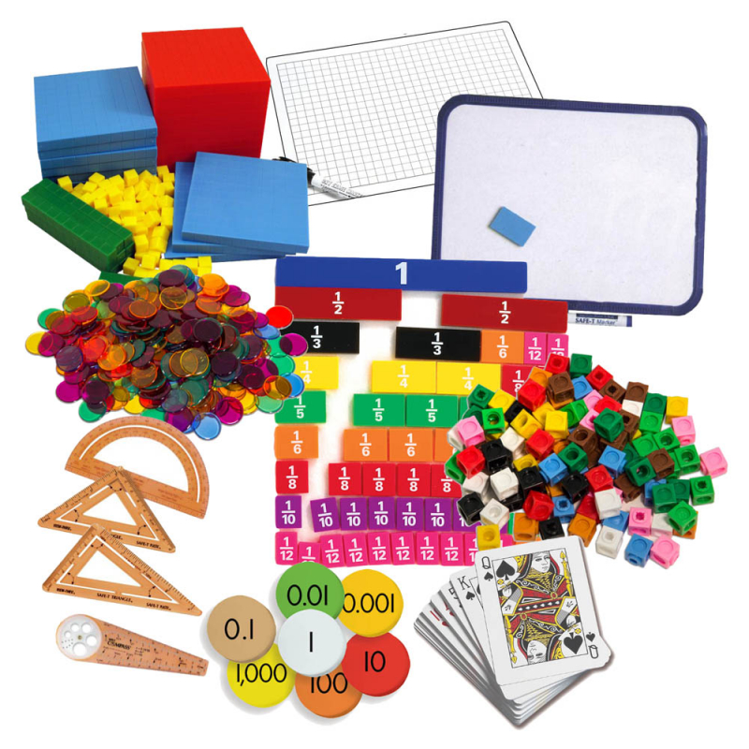
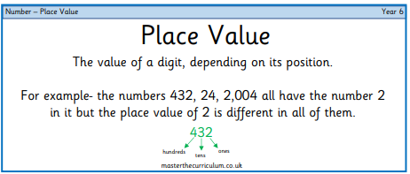


Slide 13
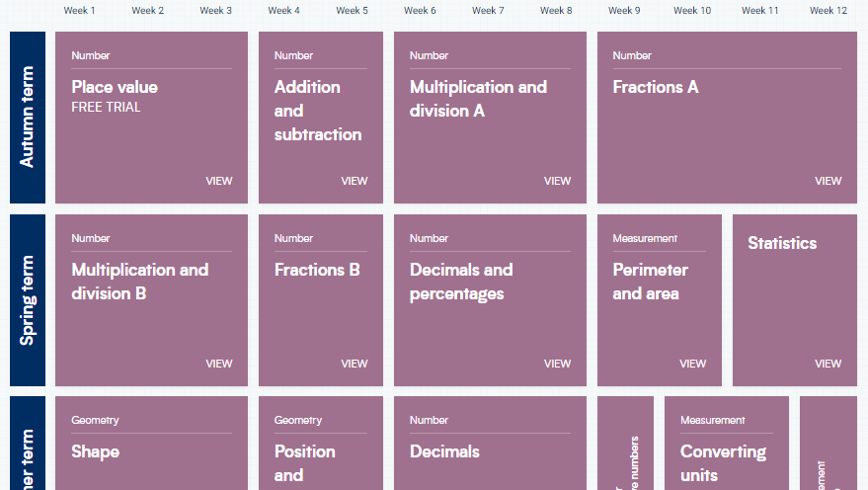

Slide 14
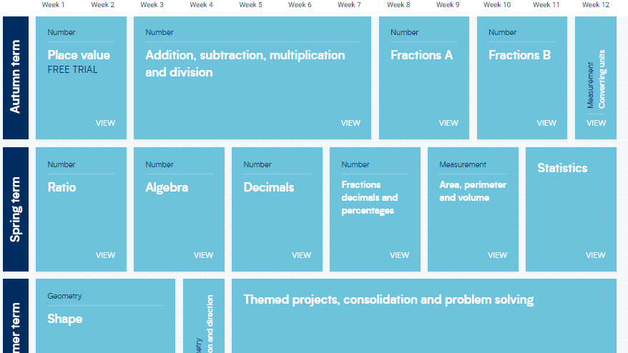

Slide 15
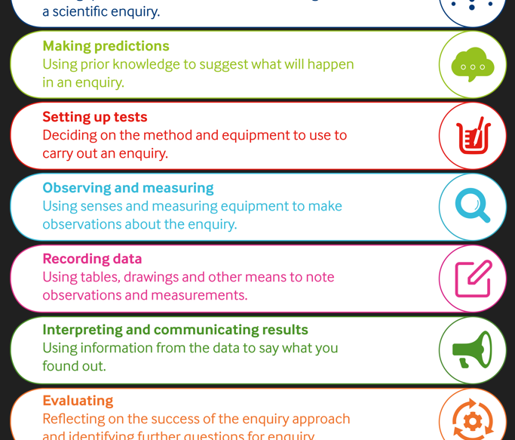
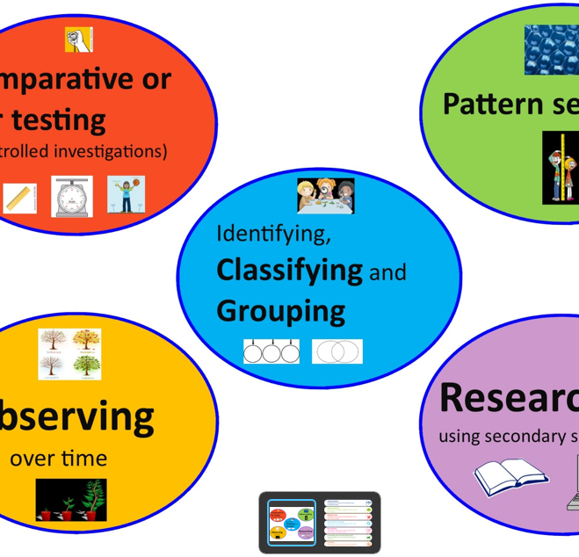
Science
Year 5 Topics:
Living things and their habitats
Forces
Animals including humans
Materials
Earth and Space
Year 6 Topics:
Electricity
Light
Animals including humans
Living things and their habitat
Evolution and Inheritance

Slide 16

Foundation Subjects
Geography
History
RE
PSHE
Computing
Music
Art
DT
MFL

Slide 17
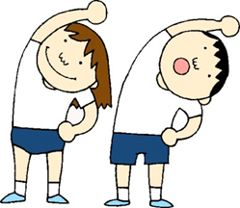
PE
Please ensure that your child has his/her PE kit in school at all times.
School T-shirt or plain white T-shirt.
Navy blue shorts.
Black trainers or pumps.
Optional items include navy joggers and navy sweatshirt or hoodie for cold weather.
Hair needs to be tied up.
Jewlery should not be worn! If earrings cannot be removed then micro pore tape should be provided to cover them.
Class | PE Days
Kestrels | Tuesdays & Fridays
Ravens | Wednesday & Thursday
Eagles | Tuesday & Thursday
Swans | Monday & Tuesday

Slide 18
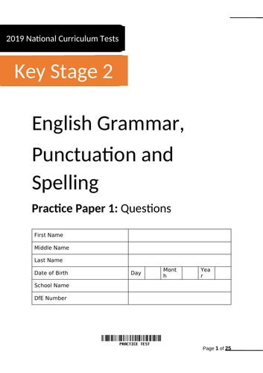
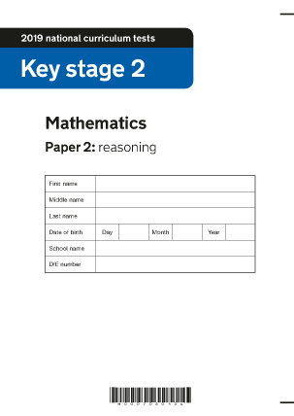
SATs (Year 6)
The key stage 2 tests are timetabled from Monday 12th May to Thursday 15th May 2025.
Mock SATs for early interventions.

Slide 19


Supporting your child at home
Reading with or to an adult and completing your reading journal
Multiplication tables on TT Rockstars.
Year 5/6 compulsary spelling words practice.
CGP books practice or online 10 minutes test for free.
https://www.cgpbooks.co.uk/resources/cgp-s-free-online-10-minute-tests
Talk to your child about current affairs using Newsround
on cbbc channel to help.
https://www.bbc.co.uk/newsround
Sometimes we will ask children to bring in something from home to present in class to support their foundation subject learning.

Slide 20
Final reminder/request:
Please only provide children with healthy snacks if you are to send them with one. Chocolates and family size crisps/snacks are not allowed in school.
Children are not allowed any juices, squashes or fizzy drinks in school. Only water is allowed in water bottles.
Please avoid sending glassware in the children’s lunch boxes as it can cause serious accidents.

Slide 21


Slide 22
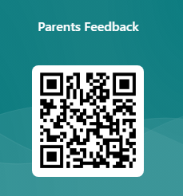
Feedback
https://forms.office.com/e/astZ6EFEAe

