Slide 1


How to support your child academically at home?

Slide 2
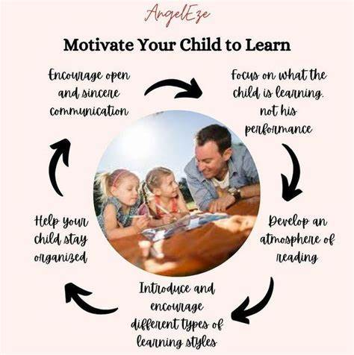

Slide 3



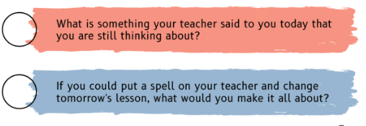
Do you ask the right questions?

Slide 4
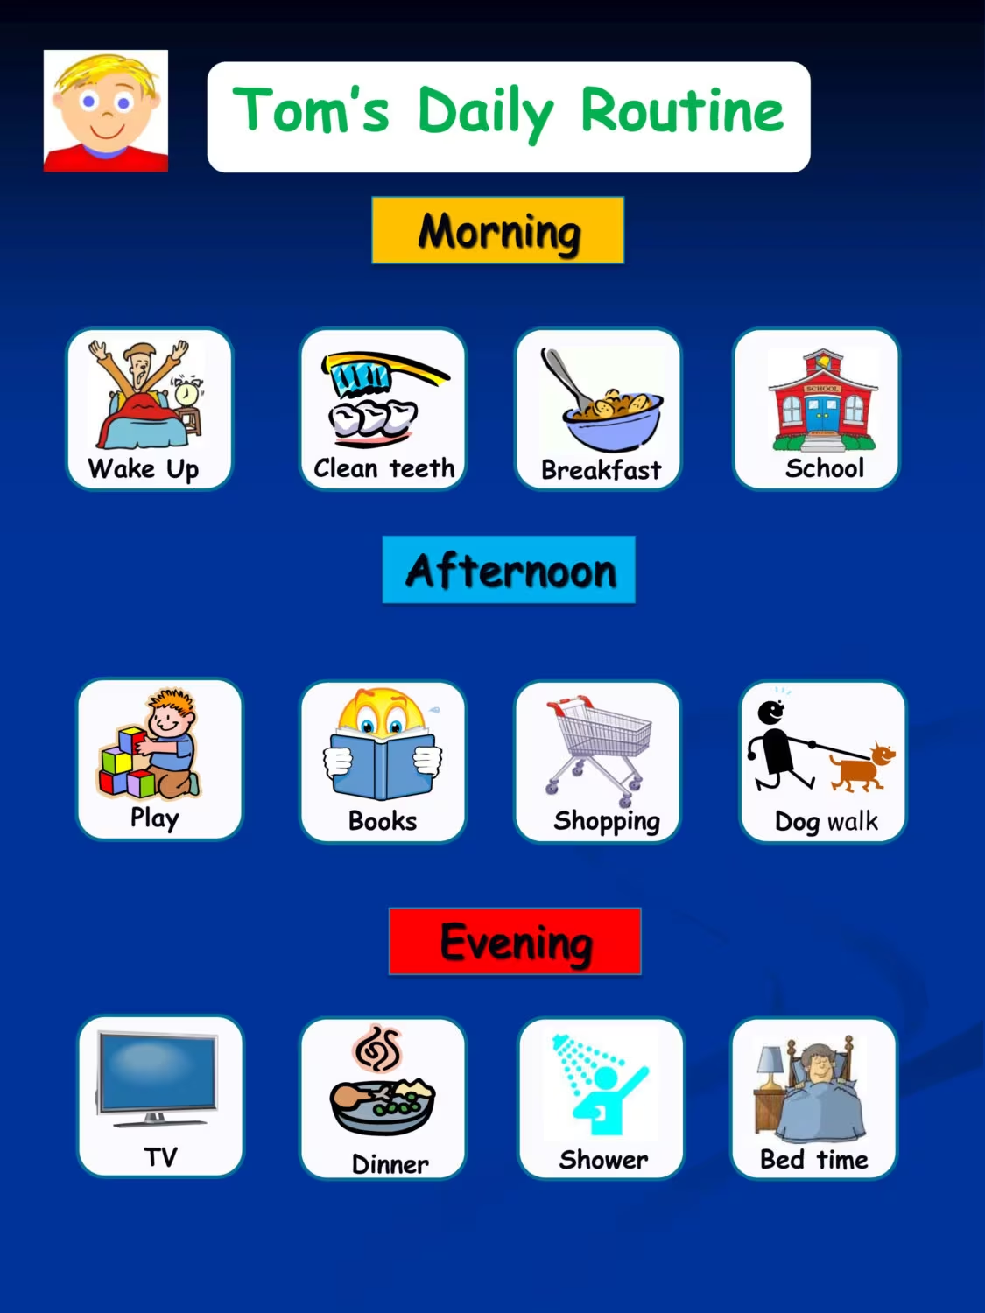
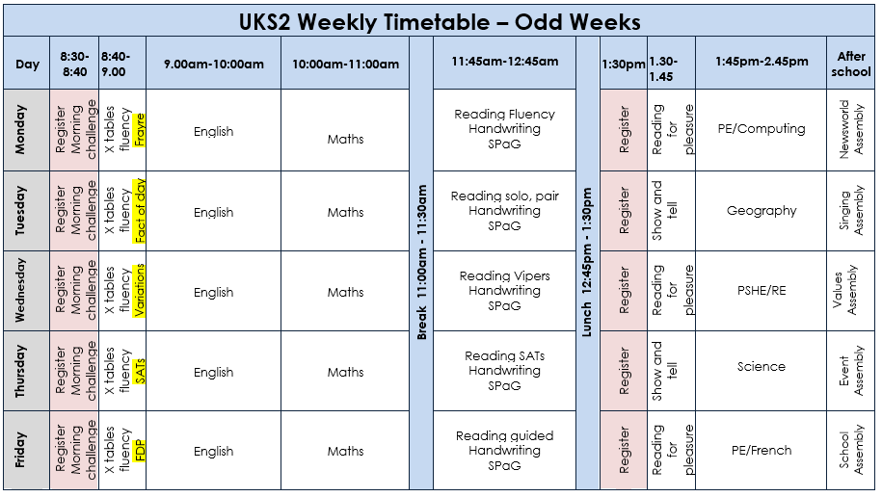
Children likes to know what is expected from them and when

Slide 5


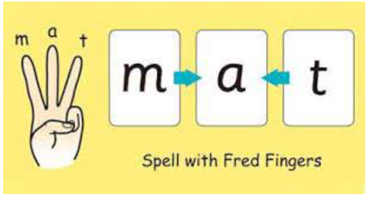
Reading is a key! It is all about phonics in KS1 in order to promote fluency later on.
Read daily with your child, using intonation and expression to achieve enjoyment rather than resistance.
When your child struggles with a word, use Fred fingers to help decode.
Understanding vocabulary is crucial: show pictures, imitate the sound or pull that face!
Bed time story is an experience that every child likes - please do not compromise it. PSHE
RWInc green book
Watch Me!

Slide 6


Reading is a key! In KS2, it is all about comprehension to promote understanding.
Read daily with your child, take it in turns, using intonation and expression to achieve enjoyment rather than resistance. (Echo, Coral, etc.)
Quality is more valuable that quantity. Is it a rich text?
Check for understanding: VIPERS!
PSHE, author intension, impression, PEE
Time your child and make it fun. In order to excel, by the age of 10, they need to be able to read between 150 words to 200 per minute. BUT, whilst comprehending!
https://www.online-stopwatch.com/timer/1minute/
Wonder text
Minute Read
Watch Me!

Slide 7
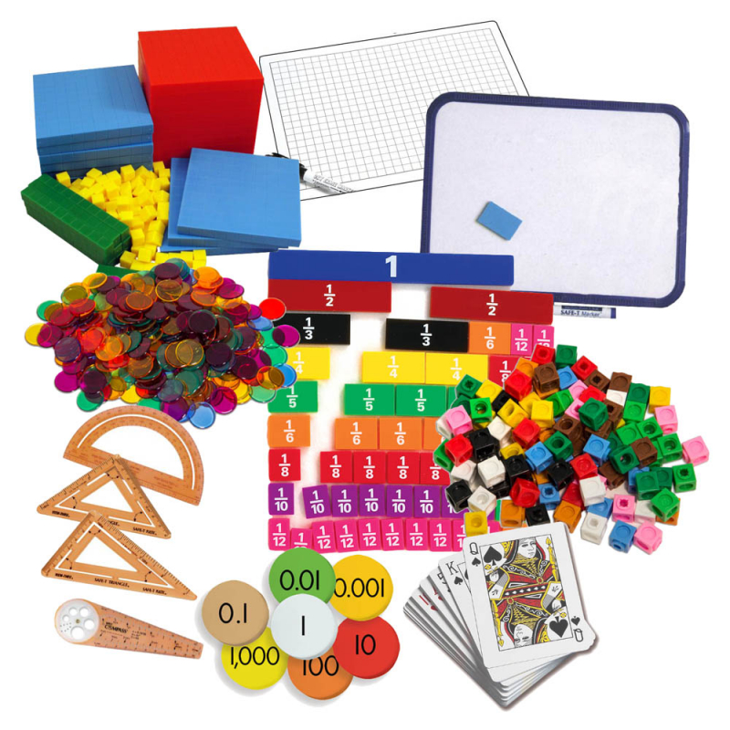
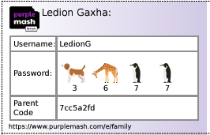
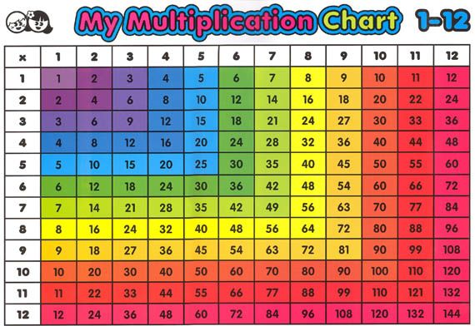
Use their passion about electronics to your stride!
Time it in order to get them ready for year 4!
https://www.purplemash.com/#tab/home/maths

Slide 8

More Maths! Go Shopping! Problem Solve!

Slide 9

Spelling Rules Taught Across KS2
Endings which sound like /ʃəs/spelt –cious or–tious
Endings which sound like /ʃəl/
Words ending in –ant,–ance/–ancy,–ent,–ence/–ency
Words ending in –able and –ible
Words ending in –ably and –ibly
Adding suffixes beginning with vowel letters to words ending in –fer
Words with the /i:/ sound spelt ei after c
Words containing the letter-string ough
Words with ‘silent’ letters (i.e. letters whose presence cannot be predicted from the pronunciation of the word)
Homophones and other words that are often confused

Slide 10

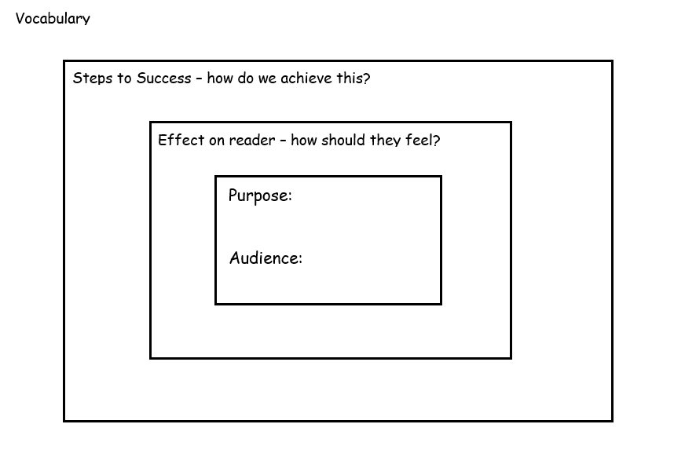

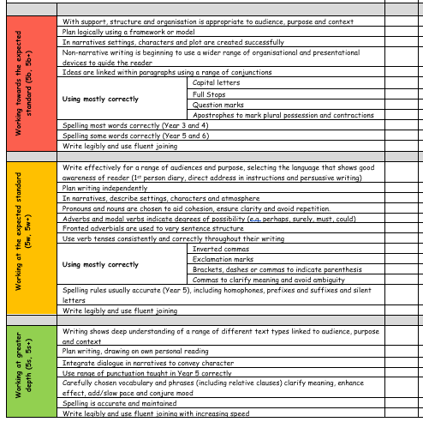
Writing!

Slide 11
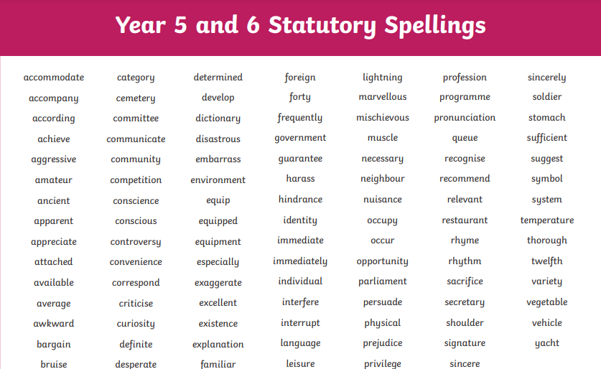

Slide 12
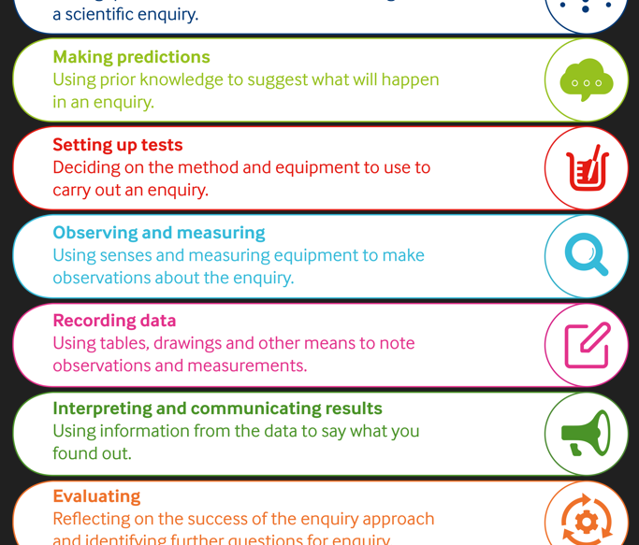
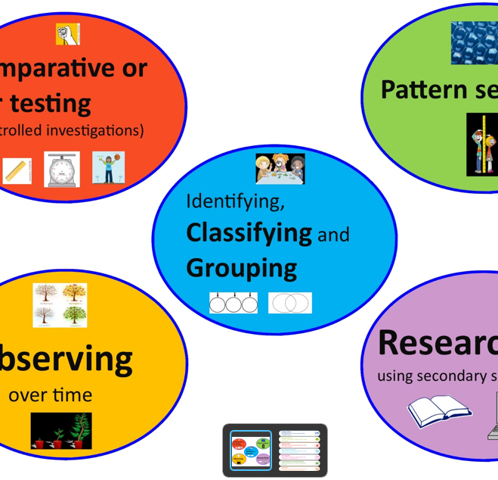
Science
https://explorify.uk/en/activities
Let’s play - I mean learn!

Slide 13


Foundation Subjects
https://www.bbc.co.uk/newsround/news/watch_newsround
Geography
History
RE
PSHE
Computing
Music
Art
DT
MFL

Slide 14
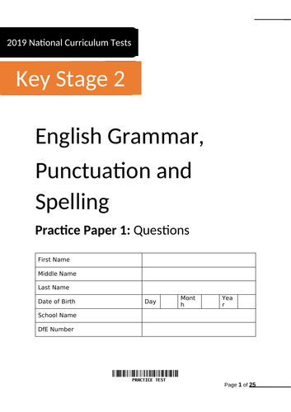
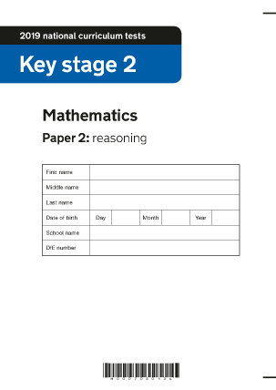
SATs (Year 6)
The key stage 2 tests are timetabled from Monday 13 May to Thursday 16 May 2024.
Mock SATs free on the gov website.

Slide 15

https://www.youtube.com/watch?v=6fq1jvIy2AE

Slide 16


Supporting your child at home
Reading with or to an adult
Multiplication tables on PurpleMash.
Common exception spelling words practice.
Work scientifically on Explorify!
https://explorify.uk/en/activities
CGP books practice or online 10 minutes test for free.
https://www.cgpbooks.co.uk/resources/cgp-s-free-online-10-minute-tests
Talk to your child about current affairs using Newsround
on cbbc channel to help.
https://www.bbc.co.uk/newsround

Slide 17


Slide 18
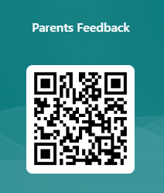
Feedback
https://forms.office.com/e/astZ6EFEAe

