Slide 1


Year 5 and 6 UKS2

Slide 2
Meet the Team
Year 5
Raven: Mr Hearfield and Mrs Mamoud
Kestrels: Ms Hall and Mrs Spitkosca
Year 6
Swans: Mrs Fox and Mrs Dinakaran
Eagles: Miss Dass and Ms Stewart

Slide 3

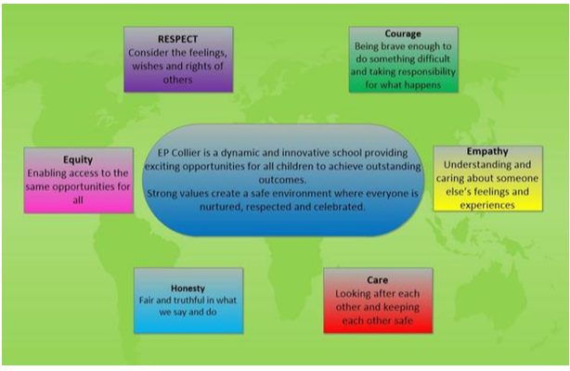
Expectations for UKS2
We expect children to:
respect and care for others
be punctual – school starts at 8.30am, register taken at 8.40am.
wear the correct uniform
obey the school rules
value and take responsibility for the school environment
We’ll help children to:
Build on their self esteem
Become confident in speaking out in class
Gain the desire to work hard and succeed
Respond proactively to adult advice and feedback
Begin to take responsibility for their own learning

Slide 4
Raise Your Childs Attendance,
-Raise their Chances!
What does “Good attendance” mean?

Slide 5
Do you know what your child's attendance is?
Do you know what it means?

Slide 6
This is Ruju. He is in Year 1 and has 90% attendance.
Is that good?
What does this mean?

Slide 7

Raju’s parents thinks this is pretty good.
However...
90% attendance = ½ day missed every week!!
Mon | Tue | Wed |  | Thur | Fri
 |  | ?
Absent half a day every week

Slide 8
Lets looks a little closer…..
1 school year at 90% attendance = 4 whole weeks of lessons MISSED!!!
38 school weeks
Sept July
 | ?
Absent for 4 weeks

Slide 9
90% attendance over 5 years of primary school….
= ½ a school year missed!
Sept July
½ a year absent from school

Slide 10

What impact might this have on Raju’s life……?
Research suggests that 17 missed school days a year = GCSE grade DROP in achievement. (DfES)
The greater the attendance the greater the achievement.

Slide 11
So 90% is not quite as good as it first seemed.
I
What can do as a parent to increase my child's attendance?

Slide 12
Ways for parents to encourage attendance:
Find out regularly your child's absence.
Talk regularly with your child about school and how they feel about it. More likely to attend if they feel supported and anxieties listened to.

Slide 13
Ways for parents to encourage attendance:
Phone us as soon as possible to tell us why your child is absent, and when you expect them to return.
Only grant days at home for genuine illness. (you will know!!)
Avoid taking holidays in school time.

Slide 14
Ways for parents to encourage attendance:
Avoid booking doctor’s and dentist appointments during the school day.
Know routines of the school day to avoid issues, e.g. have they got their PE kit?
If you have concerns please come and See Me or Mrs Barnett– I can check attendance and be discreet.
PRAISE AND REWARD GOOD ATTENDANCE

Slide 15

Attend and Achieve!
If a school can improve attendance by 1%, they will see a 5-6% improvement in attainment. (Department for Education and Skills)
Please help us and your child by ensuring their attendance remains above 95%, allowing them to achieve their potential.

Slide 16
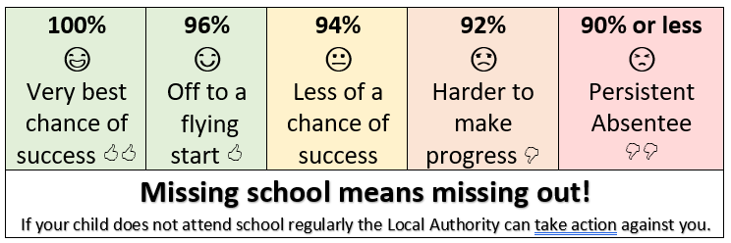
Being in school every day that it is open, is important to your child’s achievement, wellbeing, and their wider development.

Slide 17

Curriculum for UKS2
• Reading
• Writing
• SPaG (Spelling, Punctuation & Grammar)
• Maths
• Science
• Foundation subjects – History, Geography,
RE, PSHE, Art & DT.
• PE
• SATs (Year 6)
• How to support your child

Slide 18


Phonics
•Daily Read Write Inc phonics lessons for children who need them.
•Racing to English inline with the phonics programme for a bridge of fluency and comprehension activities before moving into Whole Class Reading lessons.
Whole class reading
•5 x 60-minute lessons per week
•Vocabulary, fluency reading strategies (echo, coral, independent), text discussion and reading for pleasure.
•A combination of questions and activities to explore the text with a termly focus on one skill.
•1 minute read practice to develop understanding with speed.

Slide 19

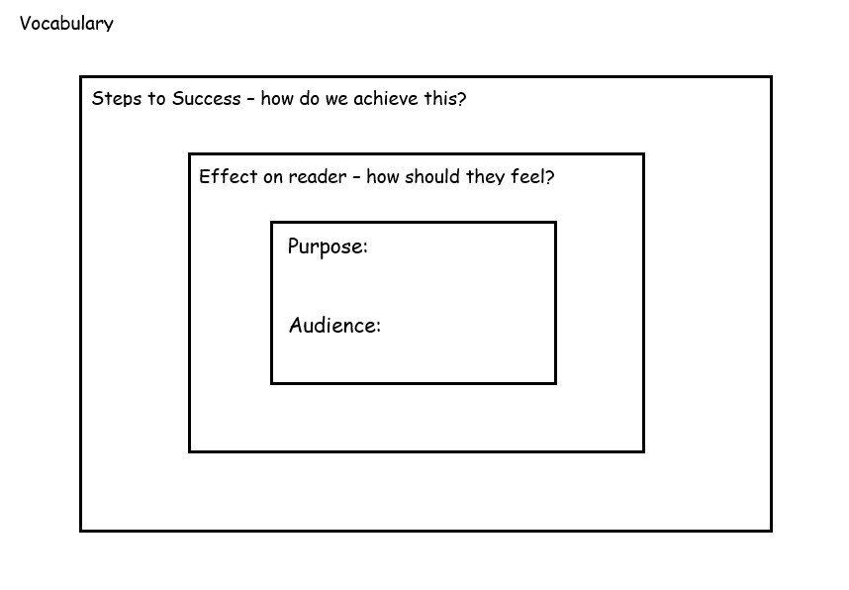
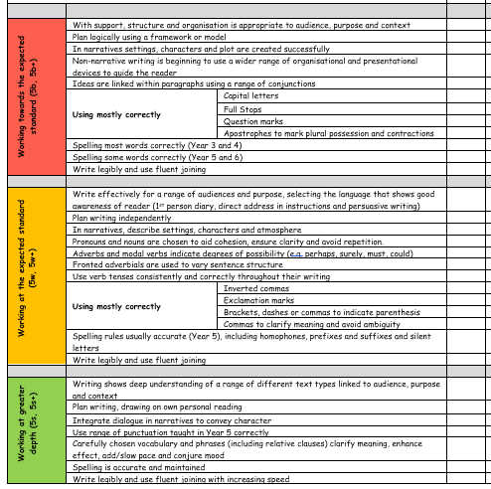
Year 5 writing Assessment

Slide 20
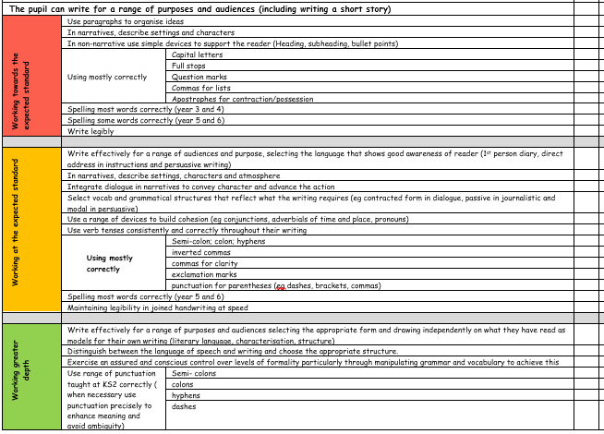
Year 6 writing Assessment

Slide 21
Spelling Rules Taught Across Year 5 and Year 6
Endings which sound like /ʃəs/spelt –cious or–tious
Endings which sound like /ʃəl/
Words ending in –ant,–ance/–ancy,–ent,–ence/–ency
Words ending in –able and –ible
Words ending in –ably and –ibly
Adding suffixes beginning with vowel letters to words ending in –fer
Words with the /i:/ sound spelt ei after c
Words containing the letter-string ough
Words with ‘silent’ letters (i.e. letters whose presence cannot be predicted from the pronunciation of the word)
Homophones and other words that are often confused

Slide 22
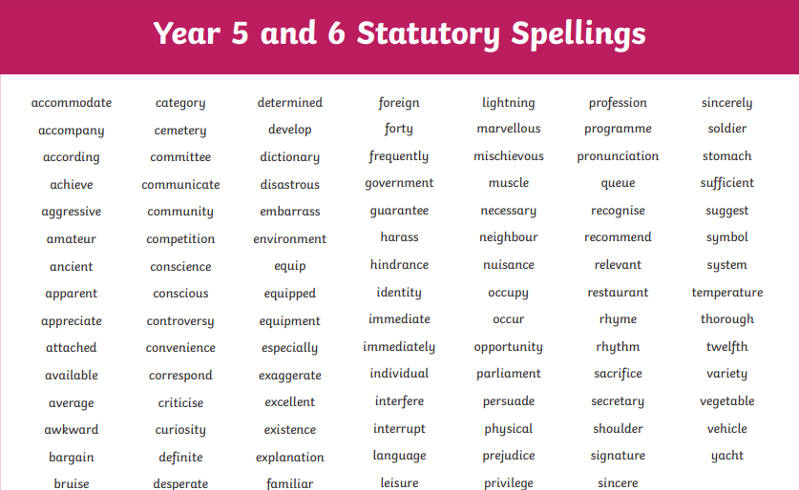

Slide 23
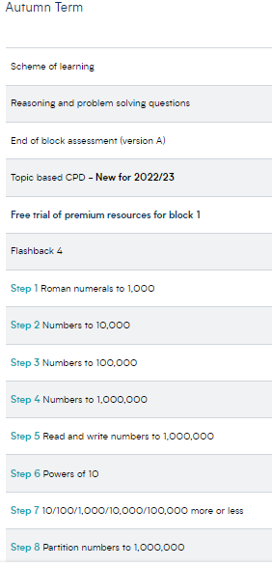

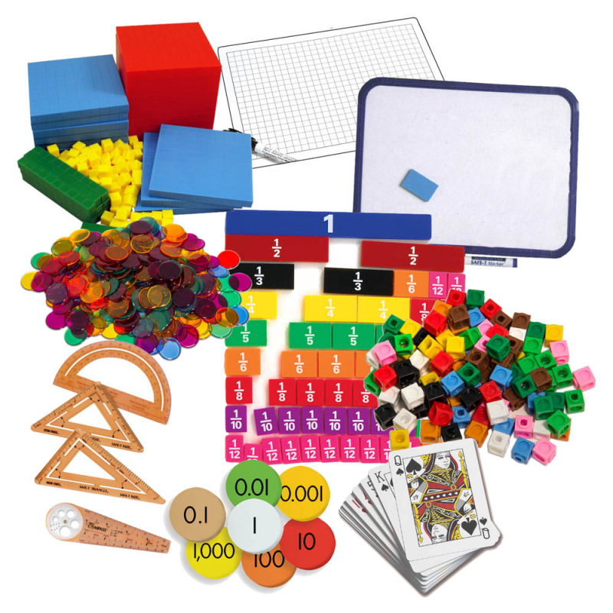
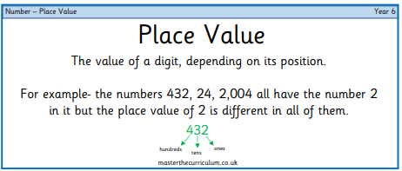


Slide 24
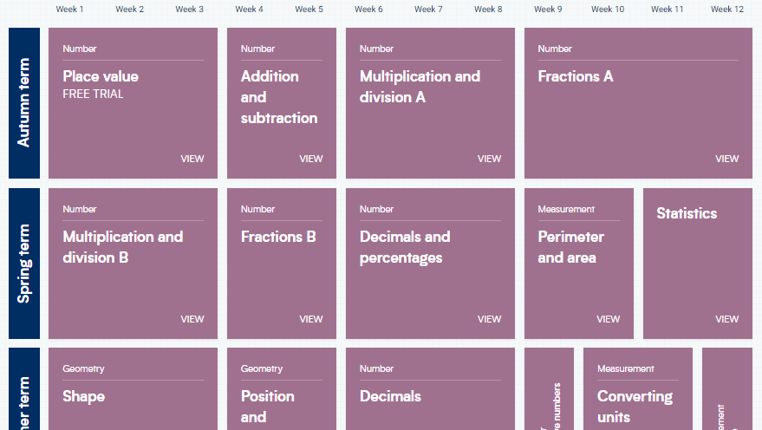

Slide 25
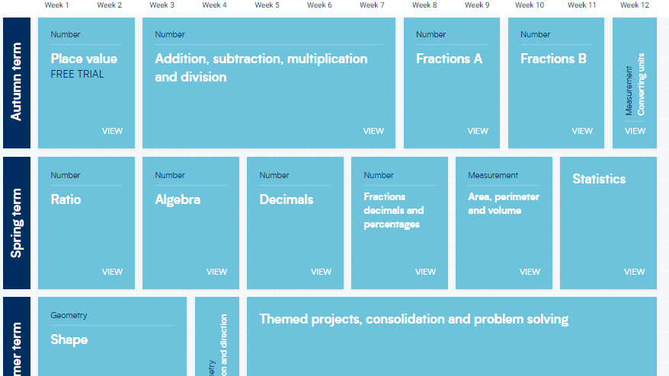

Slide 26
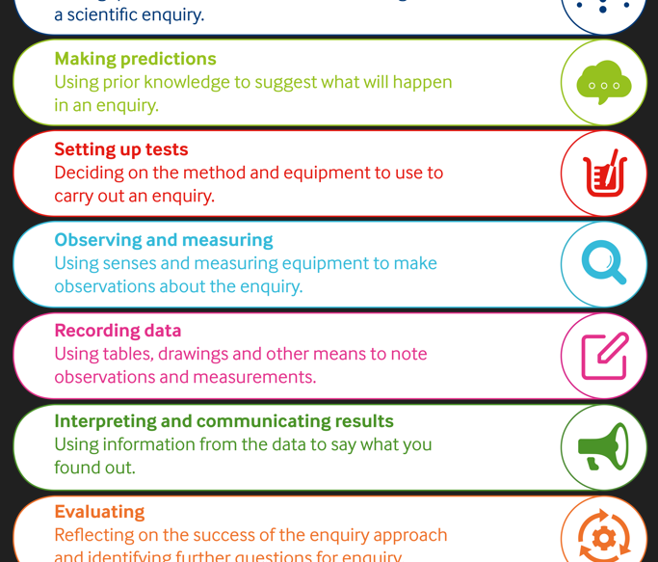
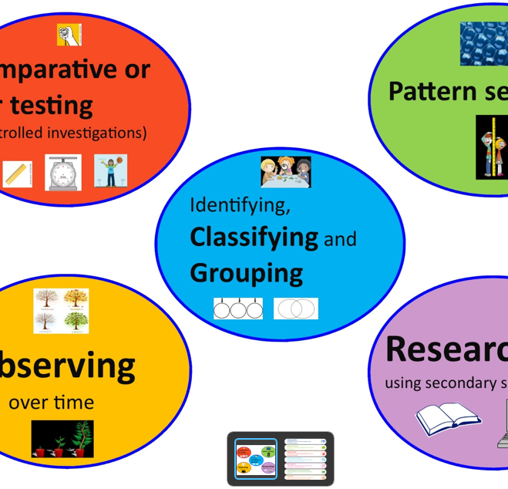
Science
Year 5 Topics:
Living things and their habitats
Forces
Animals including humans
Materials
Earth and Space
Year 6 Topics:
Electricity
Light
Animals including humans
Living things and their habitat
Evolution and Inheritance

Slide 27

Foundation Subjects
Geography
History
RE
PSHE
Computing
Music
Art
DT
MFL

Slide 28
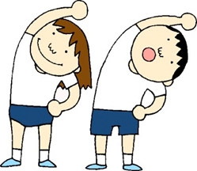
PE
Please ensure that your child has his/her PE kit in school at all times.
School T-shirt or plain white T-shirt.
Navy blue shorts.
Black trainers or pumps.
Optional items include navy joggers and navy sweatshirt or hoodie for cold weather.
Hair needs to be tied up.
Jewlery should not be worn! If earrings cannot be removed then micro pore tape should be provided to cover them.

Slide 29
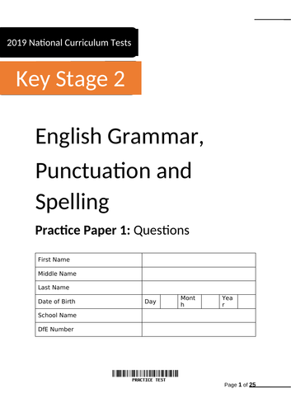
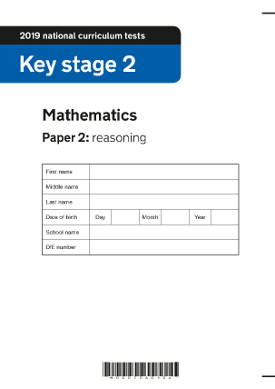
SATs (Year 6)
Monday, May 11, 2026: English grammar, punctuation and spelling papers 1 and 2.
Tuesday, May 12, 2026: English reading paper.
Wednesday, May 13, 2026: Mathematics papers 1 and 2.
Thursday, May 14, 2026: Mathematics paper 3.
Mock SATs are held during the Autumn Term for early interventions.

Slide 30


Supporting your child at home
Reading with or to an adult and completing your reading journal
Multiplication tables on TT Rockstars.
Year 5/6 compulsory spelling words practice.
CGP books practice or online 10 minutes test for free.
https://www.cgpbooks.co.uk/resources/cgp-s-free-online-10-minute-tests
Talk to your child about current affairs using Newsround
on cbbc channel to help.
https://www.bbc.co.uk/newsround
Sometimes we will ask children to bring in something from home to present in class to support their foundation subject learning.

Slide 31
Final reminder/request:
Please only provide children with healthy snacks if you are to send them with one. Crisps, chocolates and family size snacks are not recommended in school. Every week we hold a Fruity Friday where the only snack expected is a piece of fruit.
Water bottles should contain water only
They should not contain juice or fizzy drinks..
Please avoid sending glassware in the children lunch boxes as it can cause serious accidents.

Slide 32


